Slide 1
CP3405: Assessment 3 - Group (30%)
Design Sprint Submission Template
Notes:
You are free to add more slides in this template according to your work.

Slide 2
Group Members
Name | Student Number | Attended Day 1 |  | Participated Day 1 | Attended Day 2 | Participated Day 2
Anumolu Sandeep Prasad | 13156974 | Y |  | Y | Y | Y
Constant Hughes - Treherne | 13340384 | Y |  | Y | Y | Y
Udaya Bhaskar Reddy Malkannagari | 13368171 | Y |  | Y | Y | Y
Lum Kwan Wei Brandon | 13379339 | Y |  | Y | Y | Y
Problem Area 1: Local Airport |  | Problem Number 3: Safety Checks

Slide 3
Problem Area
Problem 3: Safety Checks
Currently, the safety checks on the runway (for wildlife and other hazards) at
the airport are done manually and reported manually. Manual checking is
difficult and the airport is keen to explore semi-automated methods to help staff.
Also, as these reports are manual, there is difficulty to pass this information to staff in other areas as well as when staff change shift.

Slide 4
Design Sprint Stages
Understand
Test
Diverge
Prototype
Converge

Slide 5
How we are running Design Sprint
Understand
Reflect
Diverge
Test
Day 1
Converge
Day 2
Prototype
Reflect
Test
Prototype

Slide 6
Understand
Reflect
Diverge
Test
Day 1
Converge
Day 2
Prototype
Reflect
Test
Prototype

Slide 7
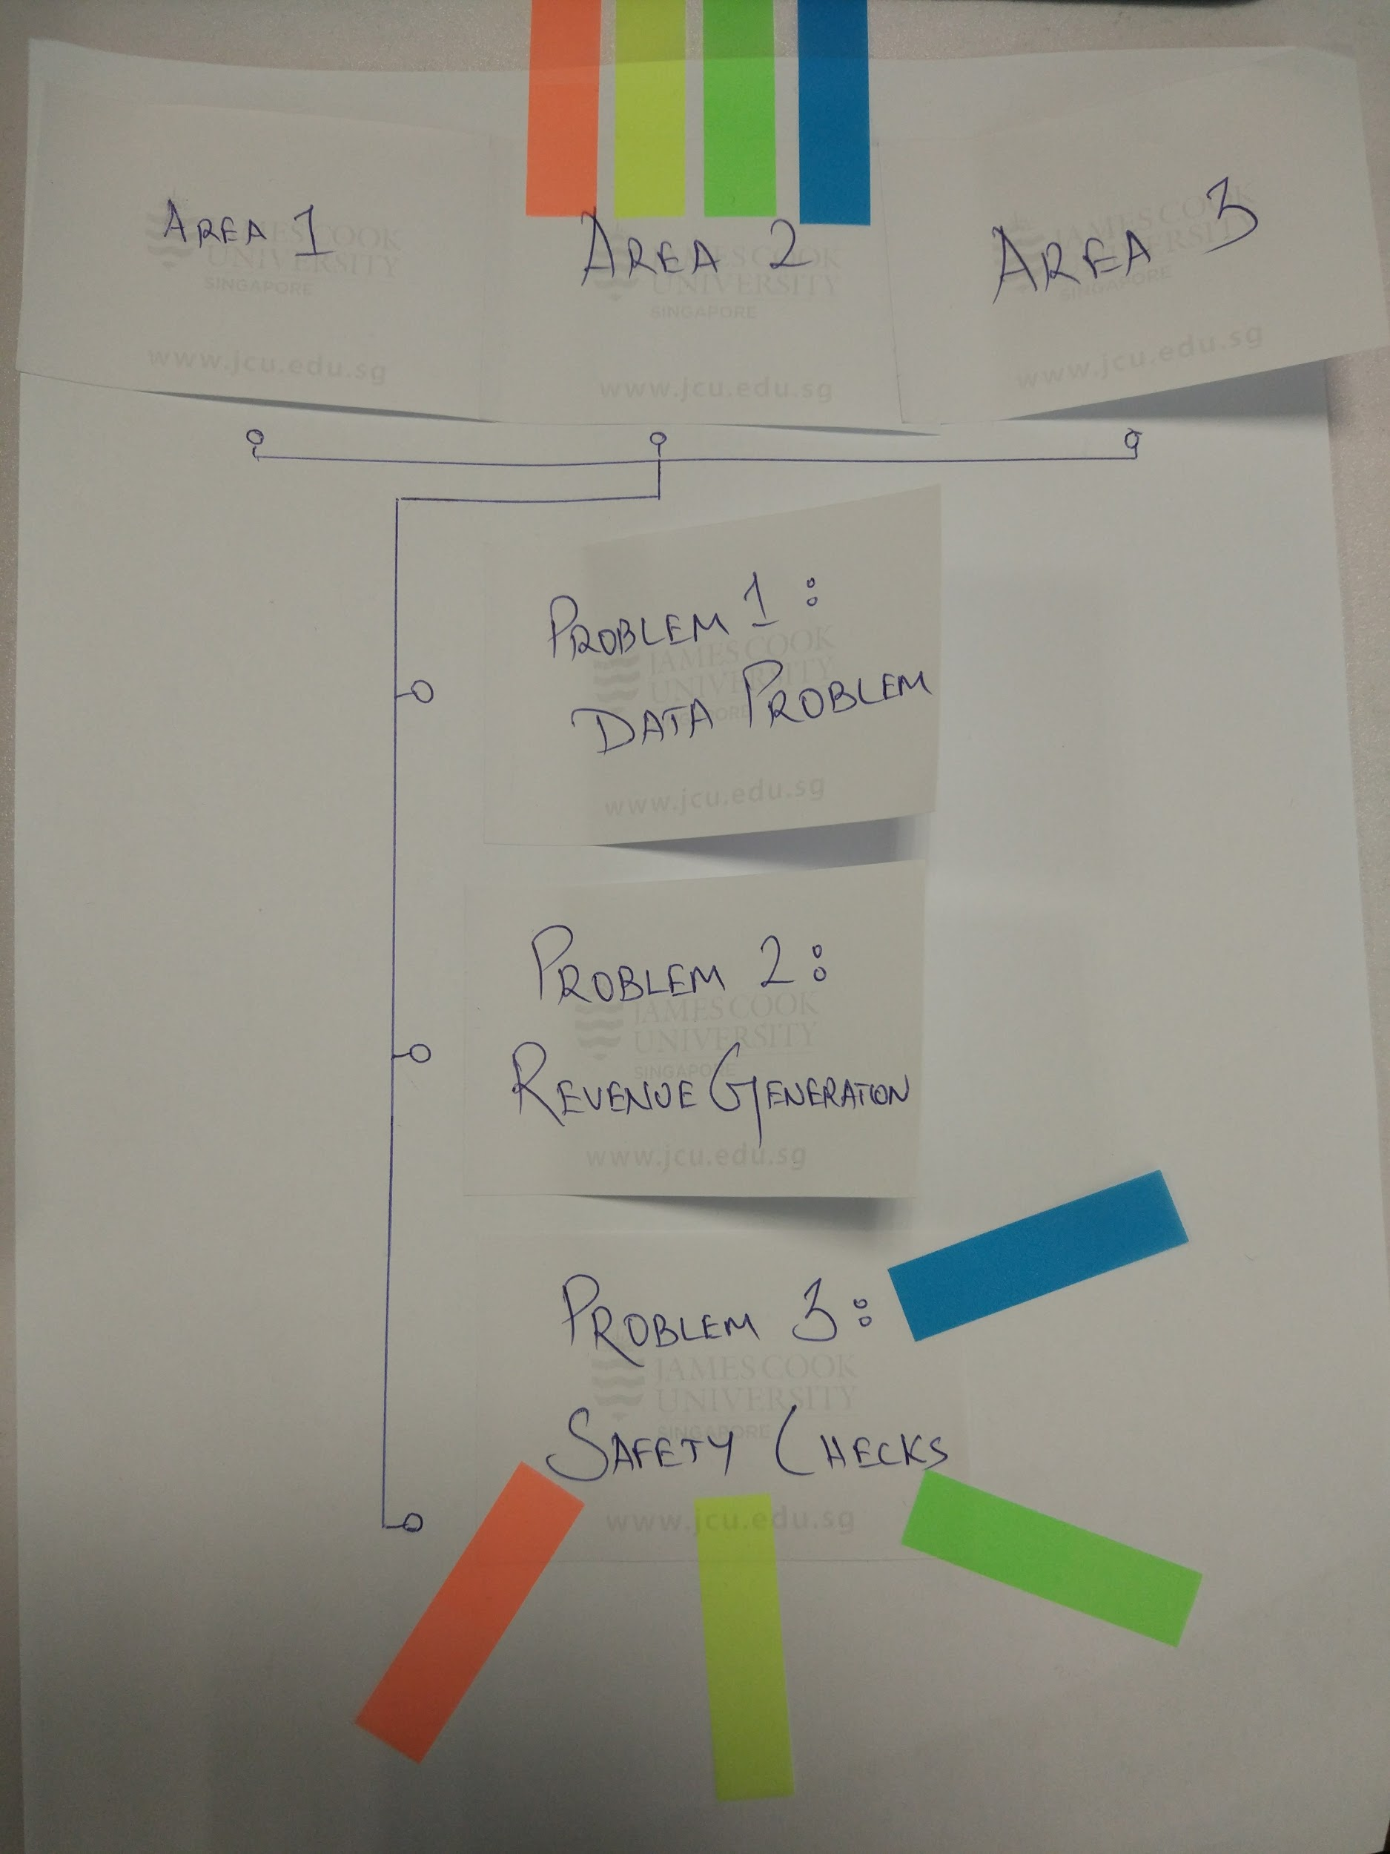
Understand Methods
Voting on idea
Our team conducted Zen voting using the colored strips provided, where each color represents each member. We arrived at Area 1 - Problem 3 - Safety Check as our chosen idea. The results of the voting are shown via the picture.

Slide 8
Voting on ideas - Colour table
Member | Color
Sandeep | Yellow
Brandon | Blue
Constant | Green
Uday | Orange

Slide 9
Primary Research 1 - Wildlife & Hazards
Title: Wildlife Hazard Management
Link: https://goo.gl/ck8Xcm
Description:
This article gives us an all inclusive description of the wildlife hazards that plague the airports and the countermeasures that can be taken to alleviate these issues. The author comes up with a detailed graphic of the percentage of wildlife species at or near the airport. Birds are counted as the major threat to the air safety with a high percentage of 80% in the overall wildlife spotted.
The author suggests multiple solutions to issues spotted. The includes the airfield grass management and night mosing to check for any wildlife in the surrounding areas. Other measures to counter the wildlife problems in the surrounding areas include waste management, water management, controlling food sources to name a few.

Slide 10
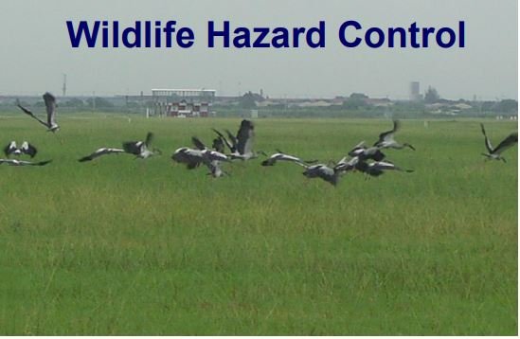
Primary Research 1 (contd.)
Solution:
Our application tries to offer a better solution to the problem identified. We plan to set up a runway monitoring system that will allow for a real-time identification of the instant threat.
The use of thermal imaging will enhance the identifiability of the hazard in real-time.

Slide 11
Primary Research 2 - Detection Methods
Title: Singapore’s Unmanned Aerial Vehicle Regulations
Link: https://goo.gl/Pn4WR9 ; https://goo.gl/z4t6po
Description:
The Singapore Government has stringent restrictions in place on UAV/ Drone activity in their air space. In specific, airports are heavily regulated with a radius of 5km around them being an actively enforced no-fly zone.
The first article above by the Civil Aviation Authority of Singapore (CAAS) describes important details and measures to be taken when operating drones in the country, as well as a permit application that is required in order to fly said drones legally and within your rights as a Singapore citizen.

Slide 12
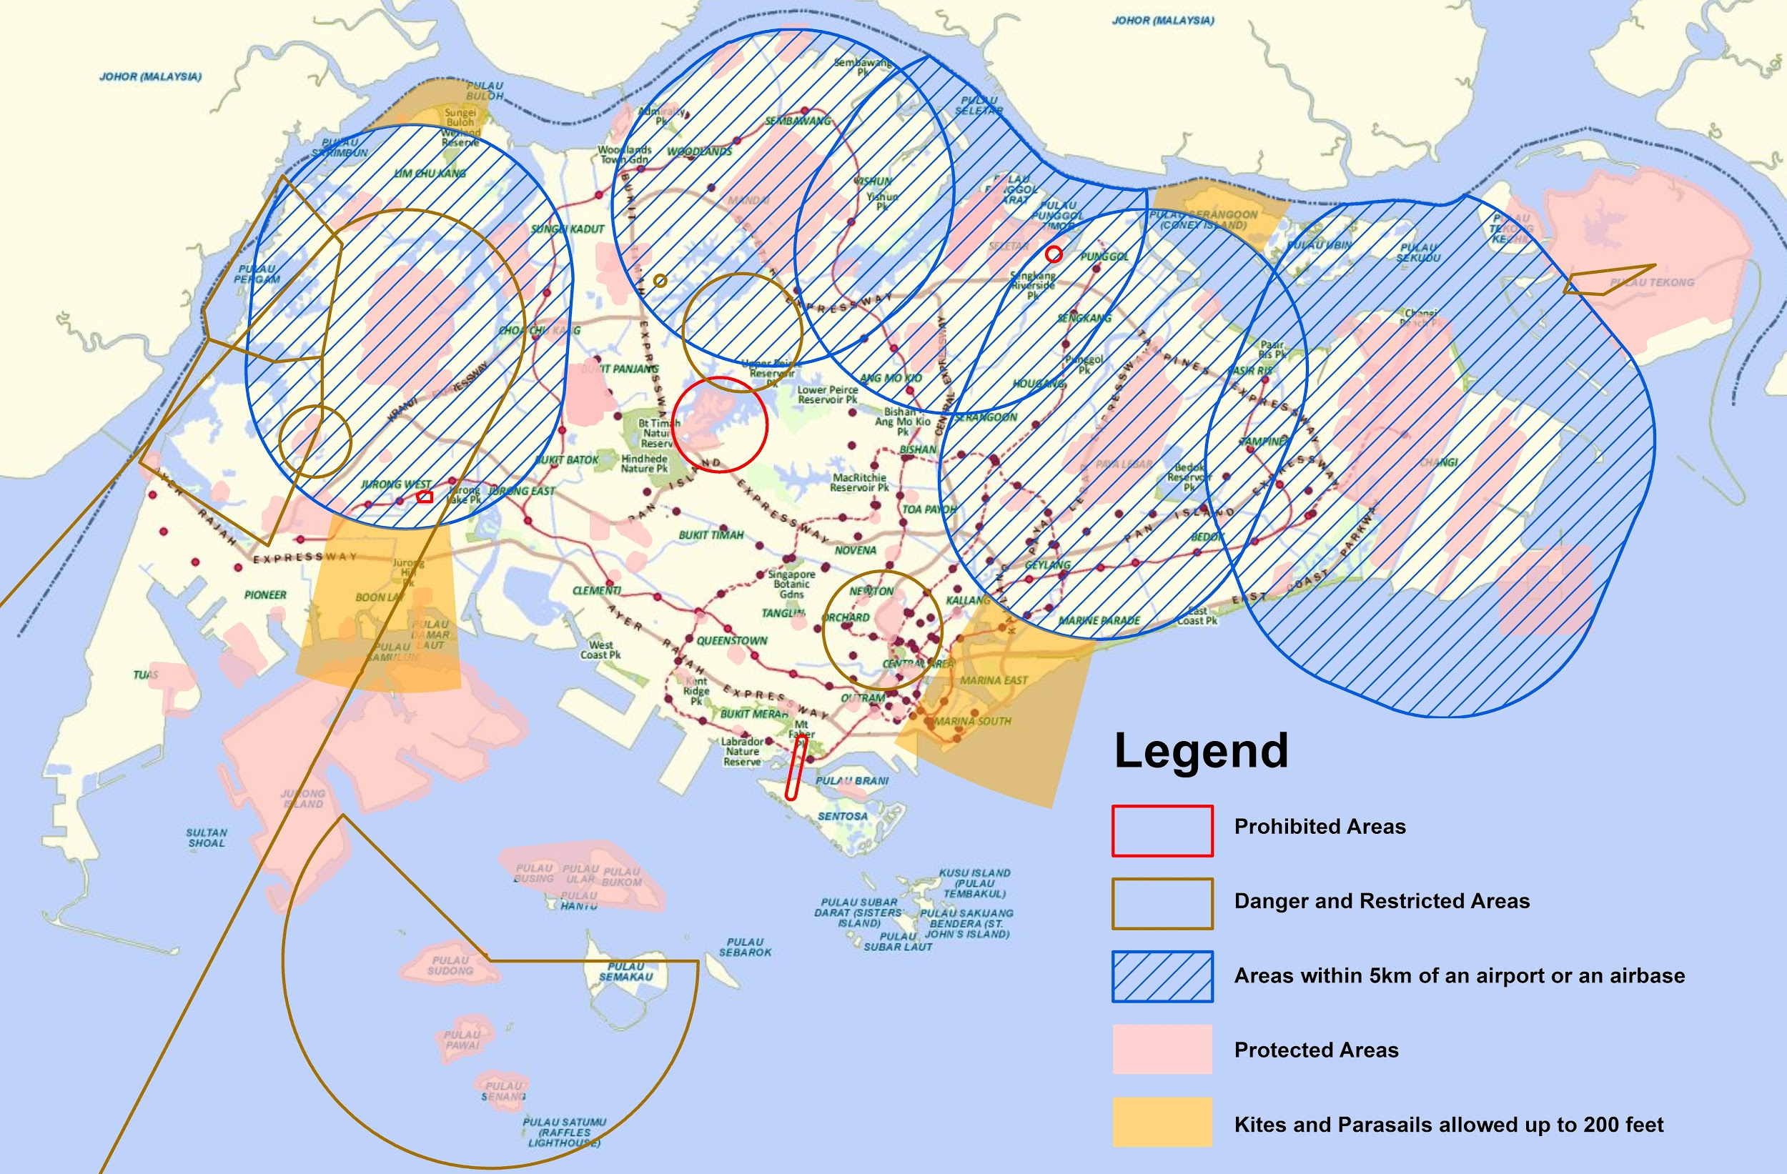
Primary Research 2 (contd.)
Our team after considering all these regulations in place, have decided that it is impractical to operate drones near the airport for surveillance because of the high risk of radio interference or worst-case scenario, direct collision onto incoming aircraft. Therefore by proceeding with a stationary detection method, we eliminate the possibility of collision and due to physical network connections, eliminate the possibility of communication interference.
We plan to propose a solution by implementing DUAL Camera/ Thermal imaging sensors at consistent intervals (100m ea.) over the length of the runway on its flanks. This in combination with our planned prototype will allow us to process the video data to reveal obstructions or wildlife on or near the runway and respond instantly by alerting the ground crew to the situation.

Slide 13
Secondary Research 1
Title: Wildlife hazard at Changi
Link: https://goo.gl/paUAKn
Description:
This article by Straits Times provides details on an Otter hazard at Changi airport in Nov-2017. Otters are known to burrow through the ground, and hence they likely dug under the security fences to get onto the runway tarmac. With our solution in place, these kinds of issues can be resolved in an accelerated time frame and with better efficiency.

Slide 14
Secondary Research 2
Title: Flight delays due to foggy weather
Link: https://goo.gl/h4mnSY
Description:
This article describes the foggy weather that causes flights to often stay in a holding pattern and is prevented from landing at the airport and is hence delayed. Our solution, while it’s main objective is to detect wildlife and hazards, can also aid by providing a better visual feed using FLIR. This can provide a clearer picture to the ATC that helps reduce the number of delays by a considerable amount.

Slide 15
Secondary Research 3
Title: API detecting objects using images
Link:https://futurism.com/google-announces-new-api-that-can-detect-and-identify-objects-using-images/
Description:
The article gives an overview of machine learning techniques can be used in detecting objects using images. Google’s tensor flow object detection is designed to work even on simple smart phones. These machine learning and data analysis can be explored further and used in identifying the obstacles on the airport runways in real time.

Slide 16
Secondary Research 4
Title: Runway Safety Solutions
Link: https://www.varec.com/docs/PRO126_Runway_Safety.pdf
Description:
The article describes the challenges posed by the obstacles on the airport runways and suggests a novel solution to counter it. A Foreign object debris detection mechanism is suggested with the use of radar and camera optics to identify the obstacles.
We can use this idea to incorporate an added element in our design.

Slide 17
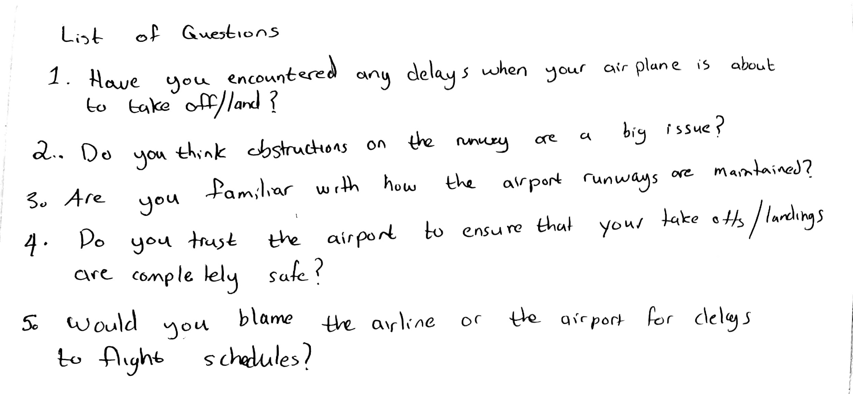
User/Problem Owner interviews
Our team performed 3-sets of interviews that targets broad areas of our idea.
Our interviewees were selected so that they would have varying perspectives on the subject. Because of this, we would have moderately different results on which we could further build future sketches and paper prototypes.

Slide 18
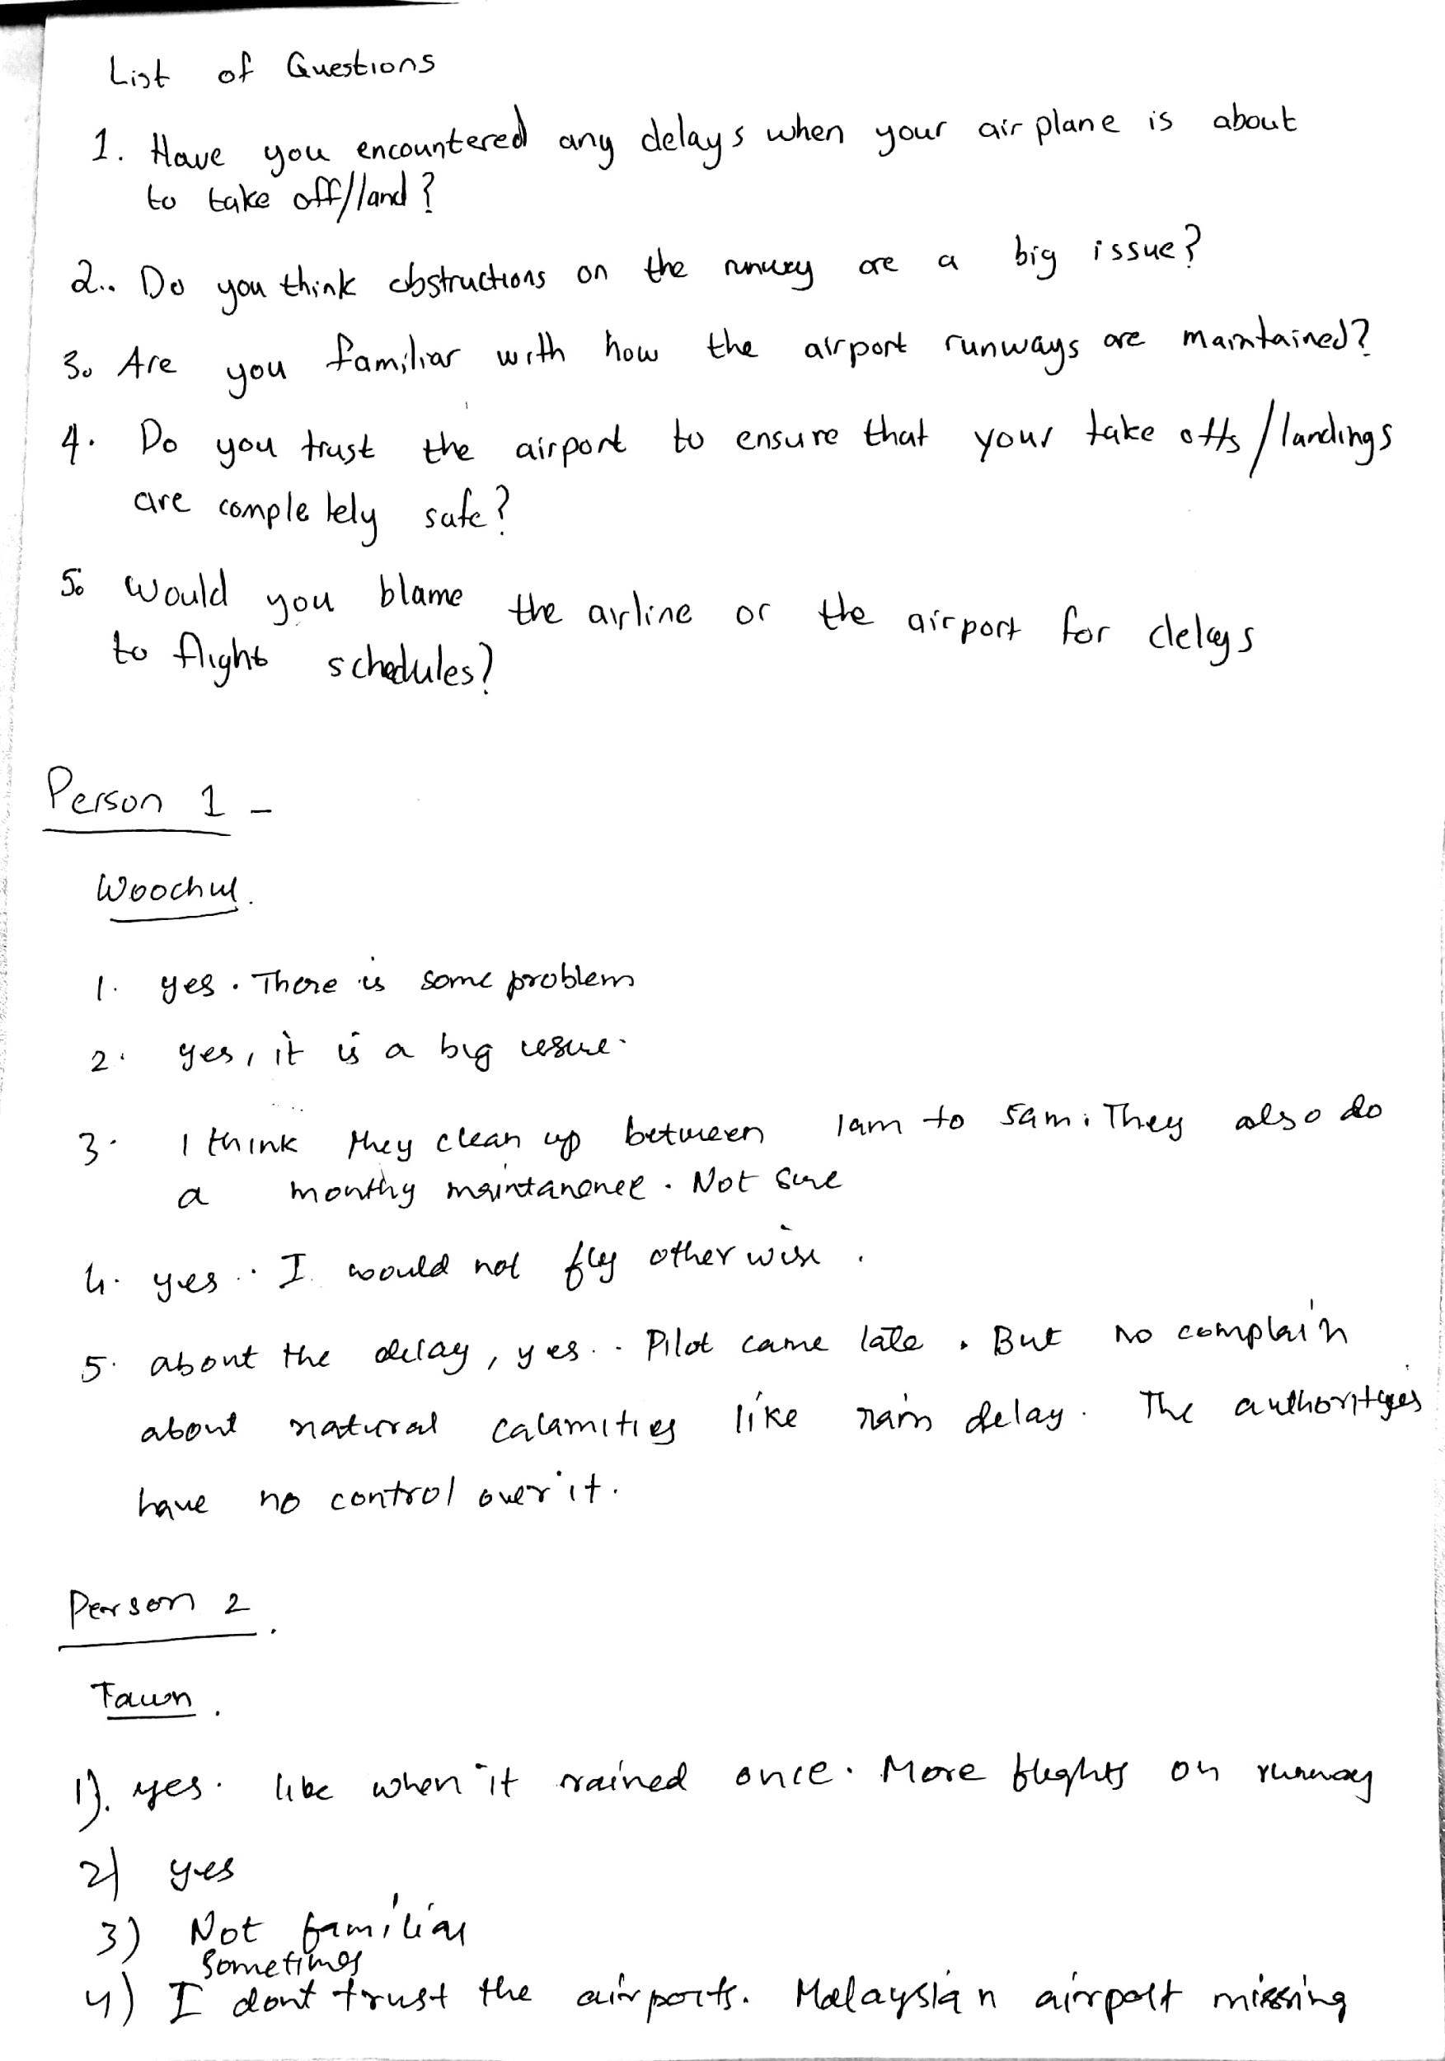
User interview #1
Name: Woochul
The interviewee was partially aware of the maintenance of the airport runways. He was not much concerned about the weather delays due to natural occurrences like rain. He considered delays due to obstructions a big issue.

Slide 19
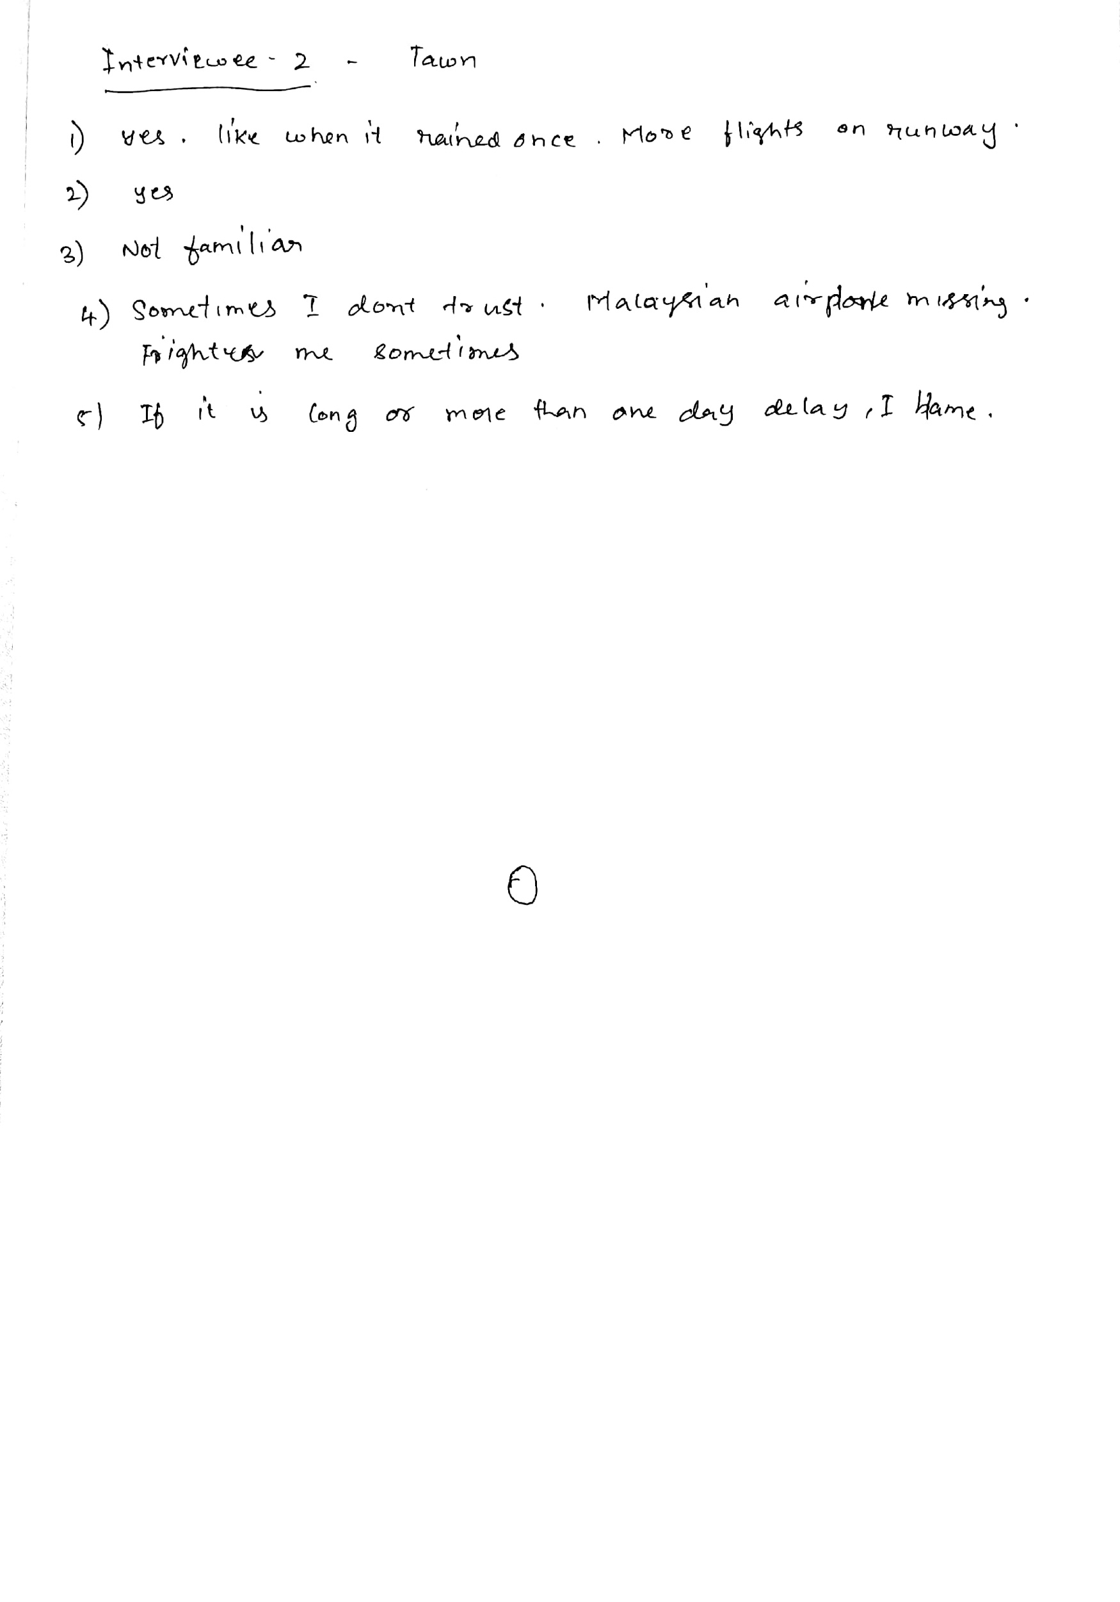
User interview #2
Name: Tawn
The interviewee was not familiar with any of the air maintenance activities that occur due to flight landings and take-offs. She was mostly concerned with the delays and opinioned thata it affects her a lot.

Slide 20
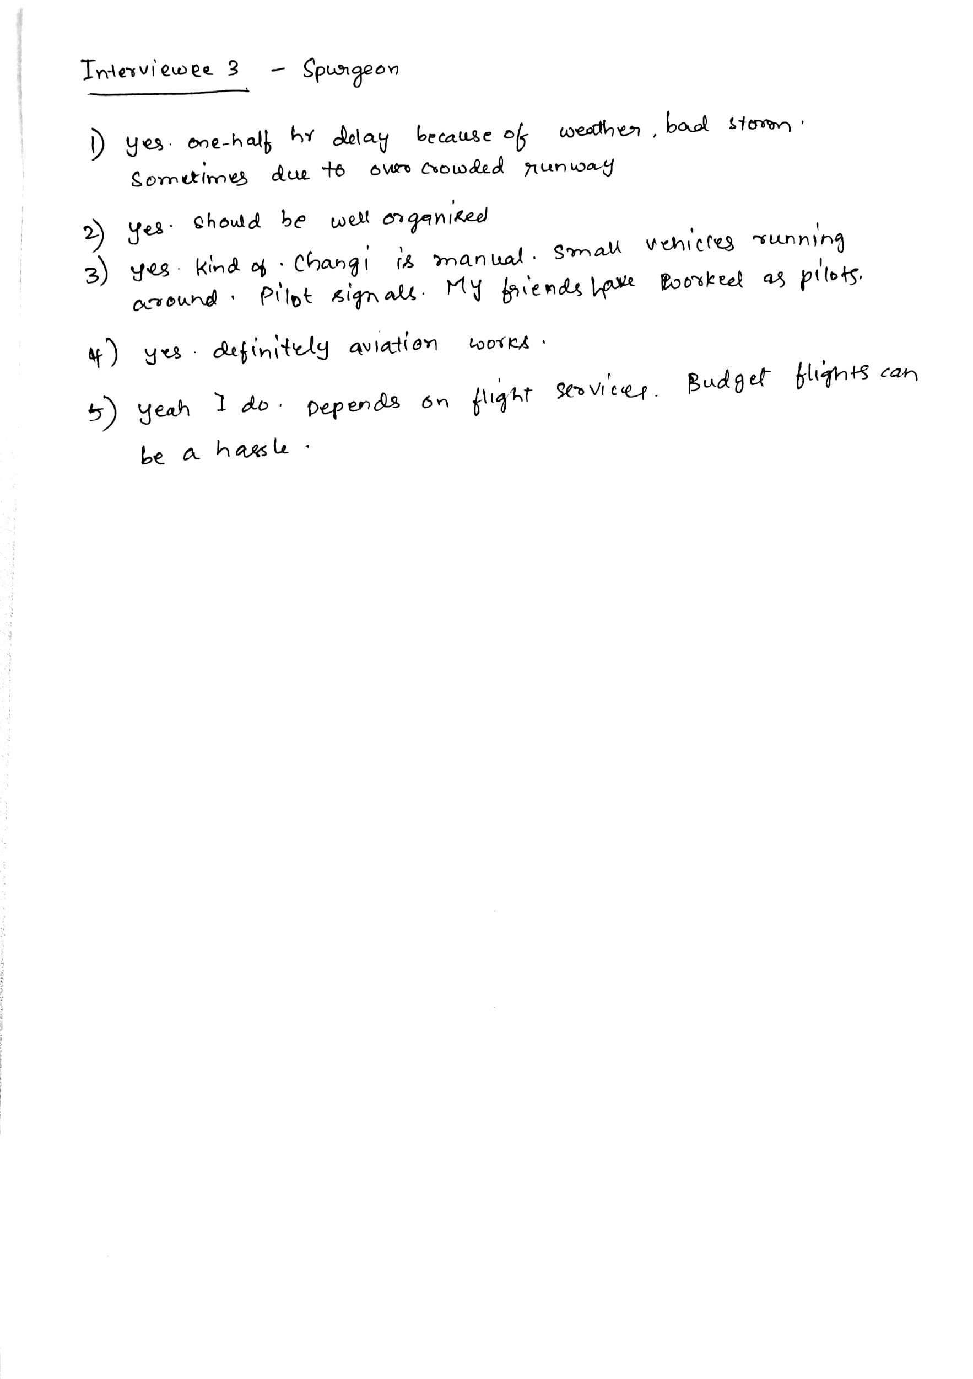
User interview #3
Name: Spurgeon
This interviewee was more aware of the airport management as he had prior interactions with his pilot friends. Flight delays caused by natural obstacles did not affect him much.

Slide 21
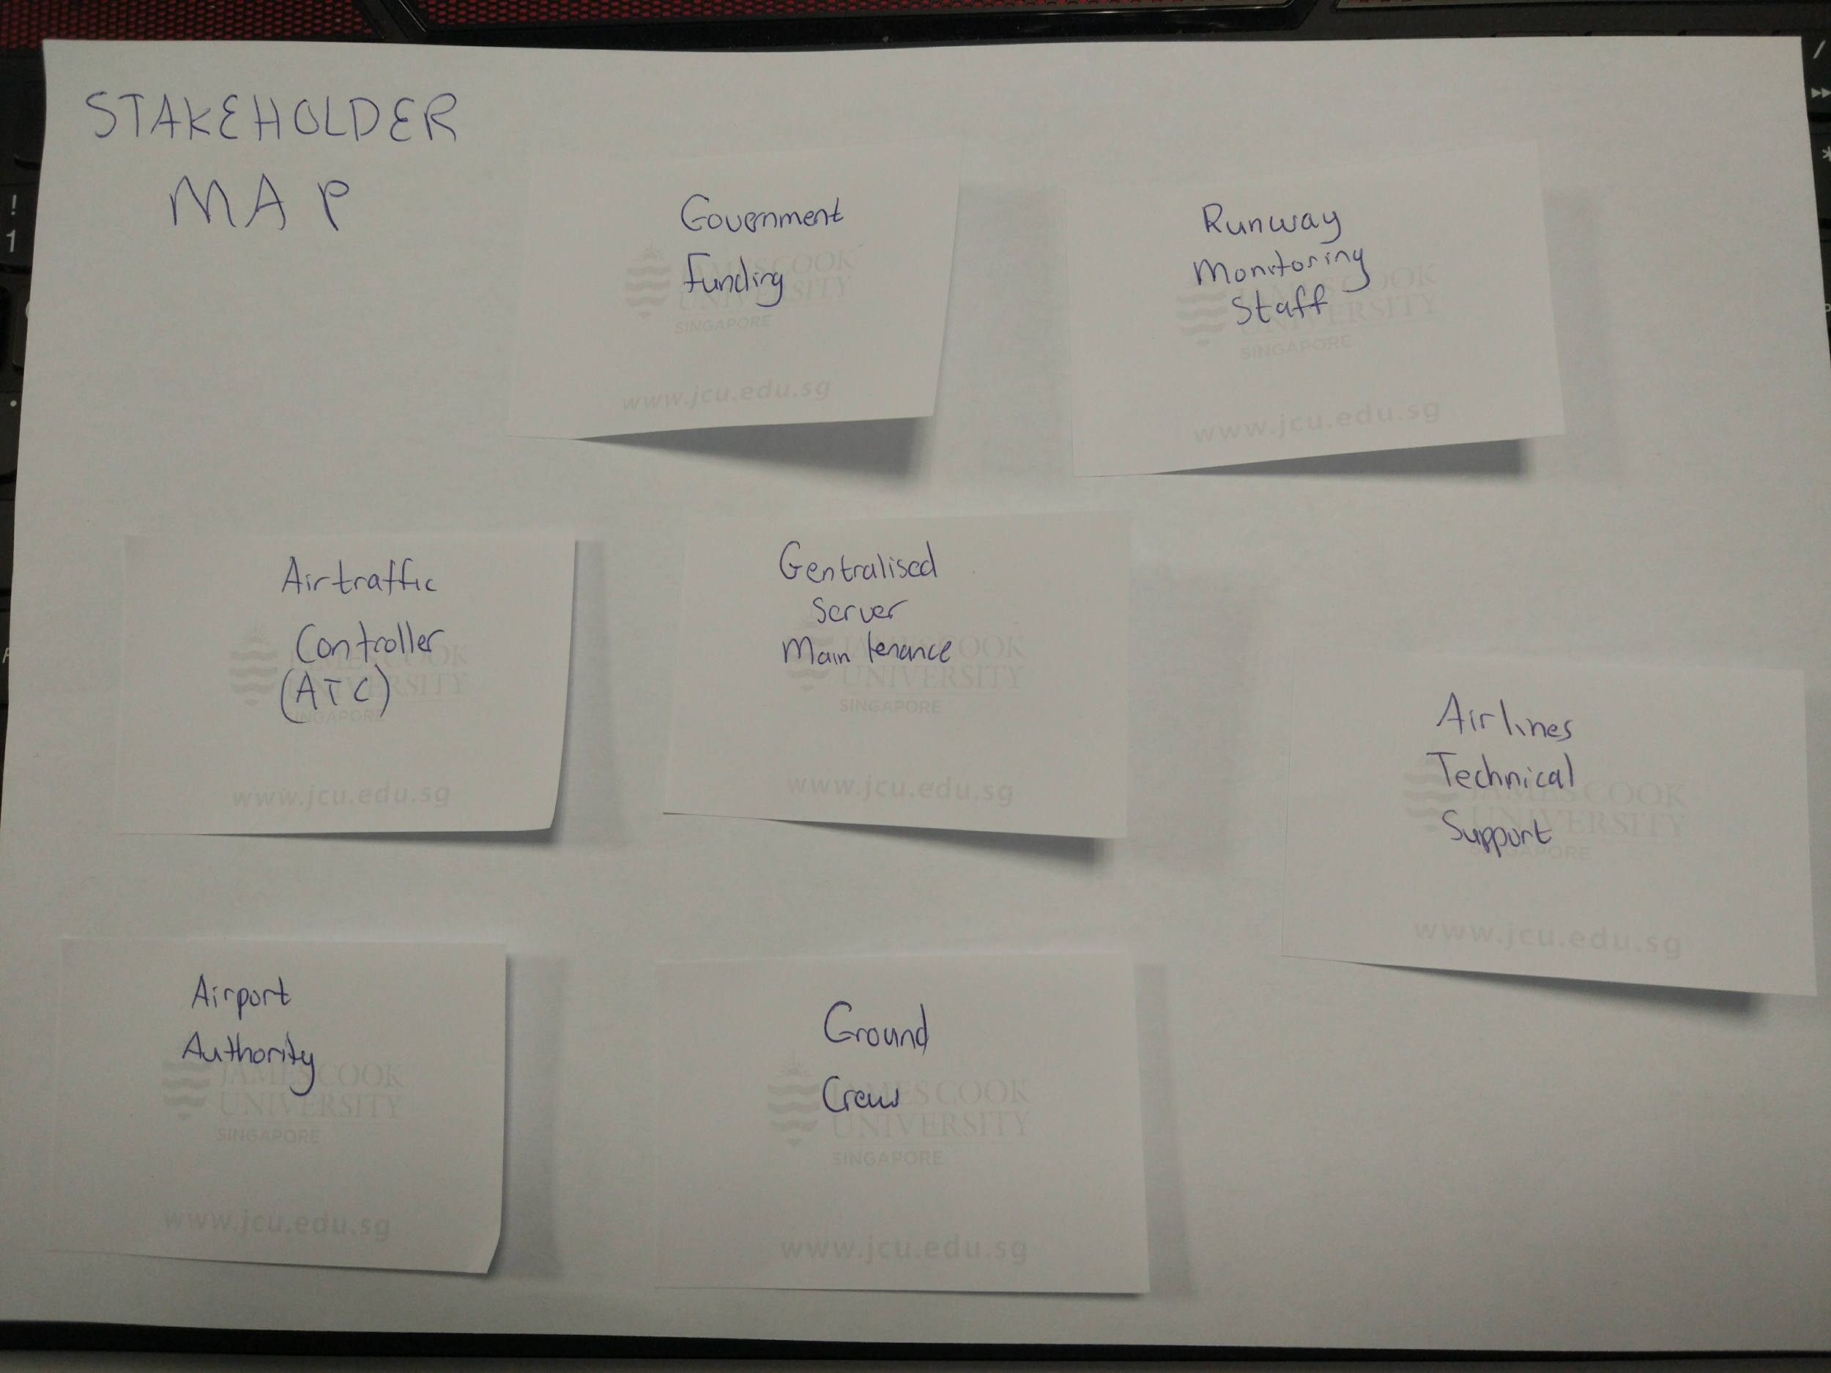
Stakeholder Map

Slide 22
Stakeholder map (Digitised)
Runway Monitoring Staff
Government Funding
Airline Technical Support
Centralised Server Maintenance
Air Traffic Controller (ATC)
Airport Authority
Ground Crew

Slide 23
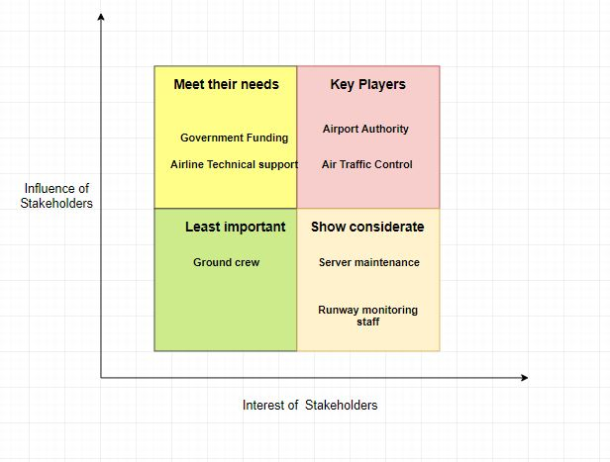
Stakeholder matrix

Slide 24
Summarize the learnings and first ideas
Extrapolating the results from our preliminary interview process and combining them with our team’s current knowledge on our idea through primary and secondary research has yielded significant breakthroughs on our philosophy and design for our proposal.
With the range of knowledge and experience on the subject varying from moderate to progressive expert, we have understood that this issue of manual labor and reporting is visible at a lower level to even the passengers of an airline. Speaking on past experiences, the interviewees have taken from their own perspective as well as that of friends working in the airline industry to express their thoughts and concerns.
Armed with this information, our team is poised to apply these elements into our proposal and use them as a benchmark to test the reasoning and basis of of all our future sketches against these interview results.

Slide 25
Persona #1
Name: Craig Bobby
Age: 45
Gender: Male
Occupation: Airport Control Tower Operator
Personality traits: Forgetful, Limited vocabulary, Unable to provide distinct descriptions
Roles and Responsibility:
Other than dealing with air traffic, when Craig identifies a problem with the Runway, he types information into a report and submits report (with appropriate urgency) to the runway crew. He then has to call the runway crew’s supervisor to notify of new report. Upon rectification of the problem, he will relay the information to the relevant traffic to resume operations. He feels this method of resolving problems is slow and inefficient, but is unable to provide an alternative to improve the process.

Slide 26
Persona #2
Name: Ange Smith
Age: 34
Gender: Female
Occupation: Ground Staff Supervisor
Personality traits: Technical, precise, adaptable
Roles and Responsibility:
As a supervisor, Ange is responsible for the recovery team’s conduct and distribution of tasks. Upon receiving an urgent (or non-urgent) report, she will use her experience to determine the nature of the problem and send out response teams accordingly. She is the main line of communication between the repair crew and the watchtower, and thus has a huge responsibility placed on her. She feels stressed from the pressure faced and wants to have some of the responsibility lifted off her shoulders.

Slide 27
Persona #3
Name: Tremayne Smith
Age: 26
Gender: Male
Occupation: Repair crew technician
Personality traits: Straightforward, Absent-minded
Roles and Responsibility:
Being part of the repair crew, Tremayne follows the instructions of the shift’s supervisor and heads towards problem areas that require maintenance or immediate repair. Upon rectification of the problem, he heads back to the supervisor and informs his/her of the evaluation. He feels that the act of having to report the problem to a supervisor to be menial, and wants a better solution to report the resolution of the problem.

Slide 28
Three Words
Efficiency, Communication, Safety

Slide 29
Understand
Reflect
Diverge
Test
Day 1
Converge
Day 2
Prototype
Reflect
Test
Prototype

Slide 30
Diverge Methods
Sketching 8 ideas within 5 minutes
For the following section of sketch ideas, we have split the images per slide to represent 4 sketches per slide. So, the total of 8 sketches will be represented in 2 slides per member.
Improve on 1 idea within 5 minutes
In this section, certain screens were critiqued internally to allow for improvements on the existing designs. A fresh point of view will aid greatly as an individual mindset might miss fairly obvious features.

Slide 31
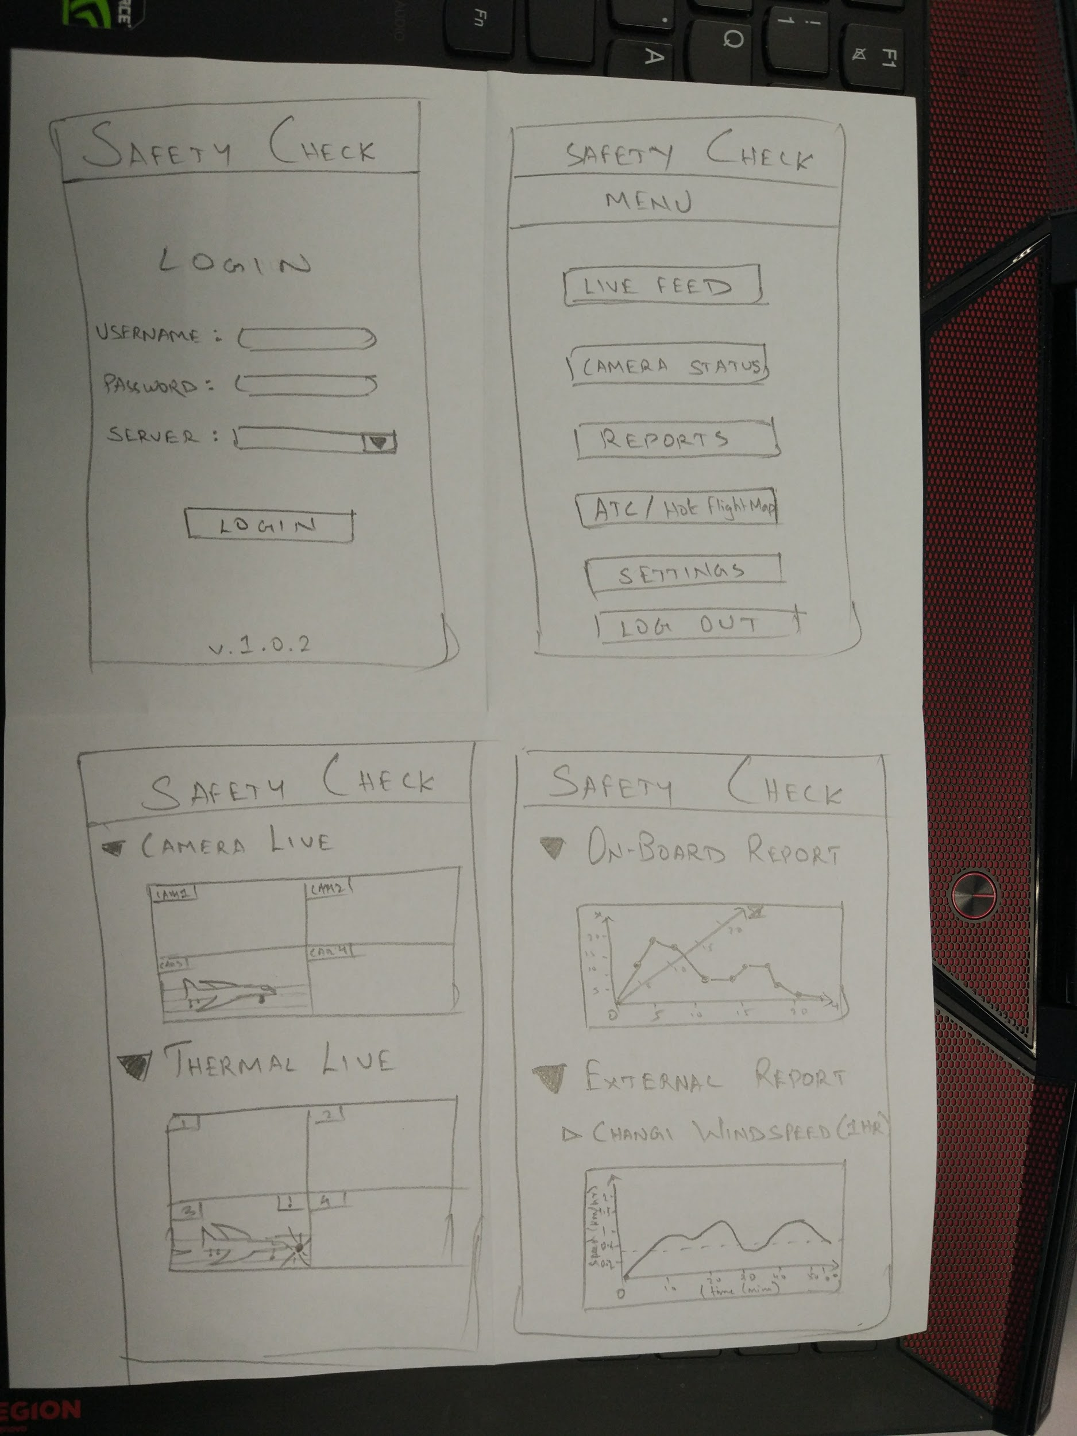
Sketch 8 ideas within 5 minutes – Sandeep
This sketch depicts a few pages of our team’s intended ATC admin application, which will be accessible only by specific authorized personnel operating in the Air Traffic Center Tower at Changi airport.
It offers the full fledged functionality of our proposal, with live camera and thermal imaging to live onboard flight camera telemetrics and ground station weather tracking.

Slide 32
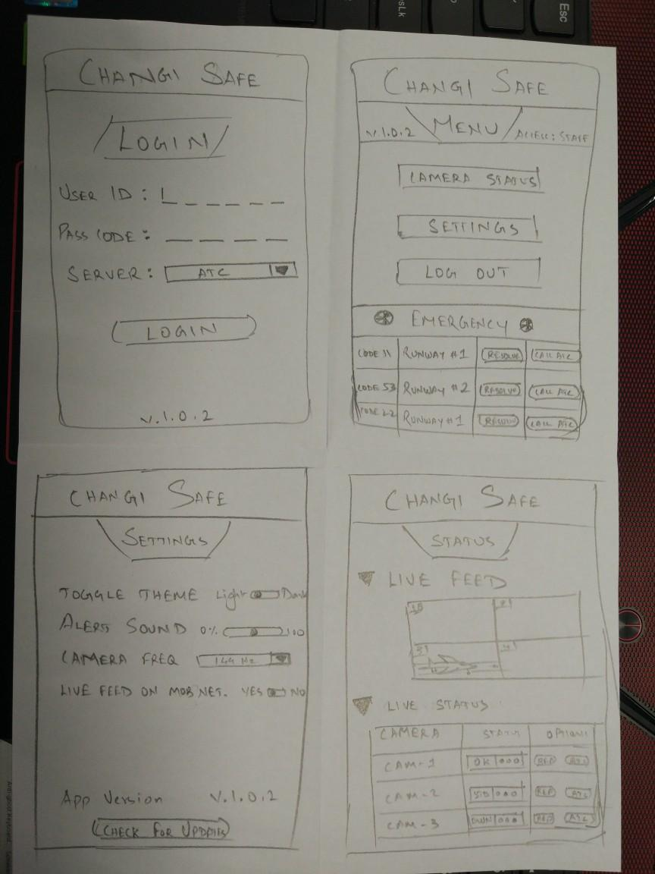
Sketch 8 ideas within 5 minutes – Sandeep (2)
This sketch represents the UI of the airport staff application, which is more restrictive in features but requires a lesser access level.
This prototype demonstrates the pivotal principle of the staff being able to rapidly receive information from the ATC and react to incidents and inversely, report problematic incidents.

Slide 33
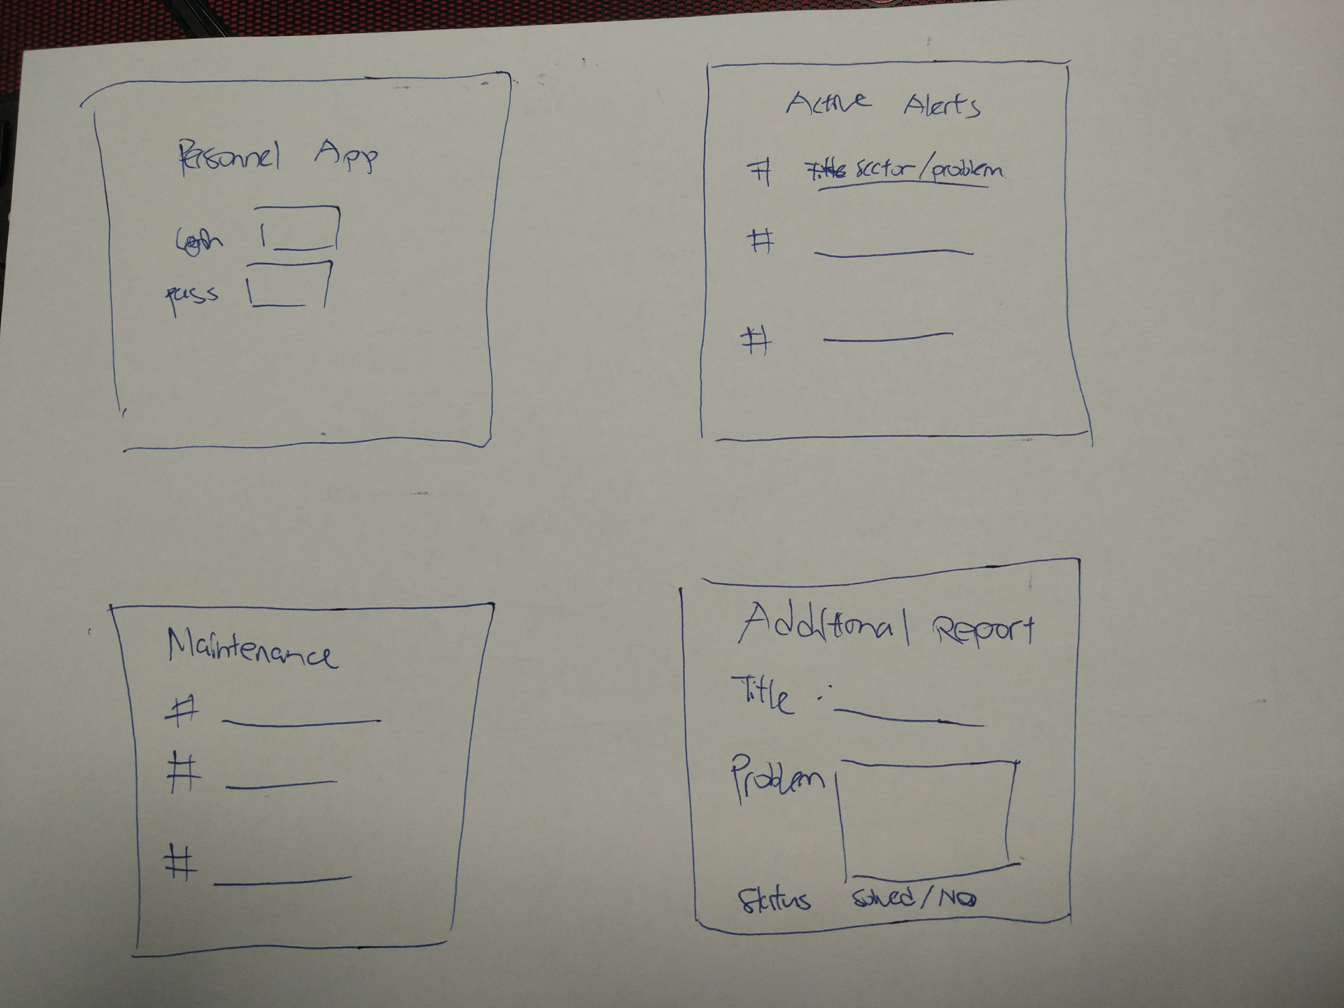
Sketch 8 ideas within 5 minutes – Brandon
The top left sketch shows the Login screen of the application, with a simple username and password input.
The top right sketch shows the active alerts of the application, where it will state in which sector the problem is, as well as the nature of the situation.
The bottom left sketch shows the upcoming maintenance list; At which sector is the routine maintenance due to be conducted.
The bottom right sketch shows the additional report screen, where the user can report a new problem that arises, complete with categorisation and information.

Slide 34
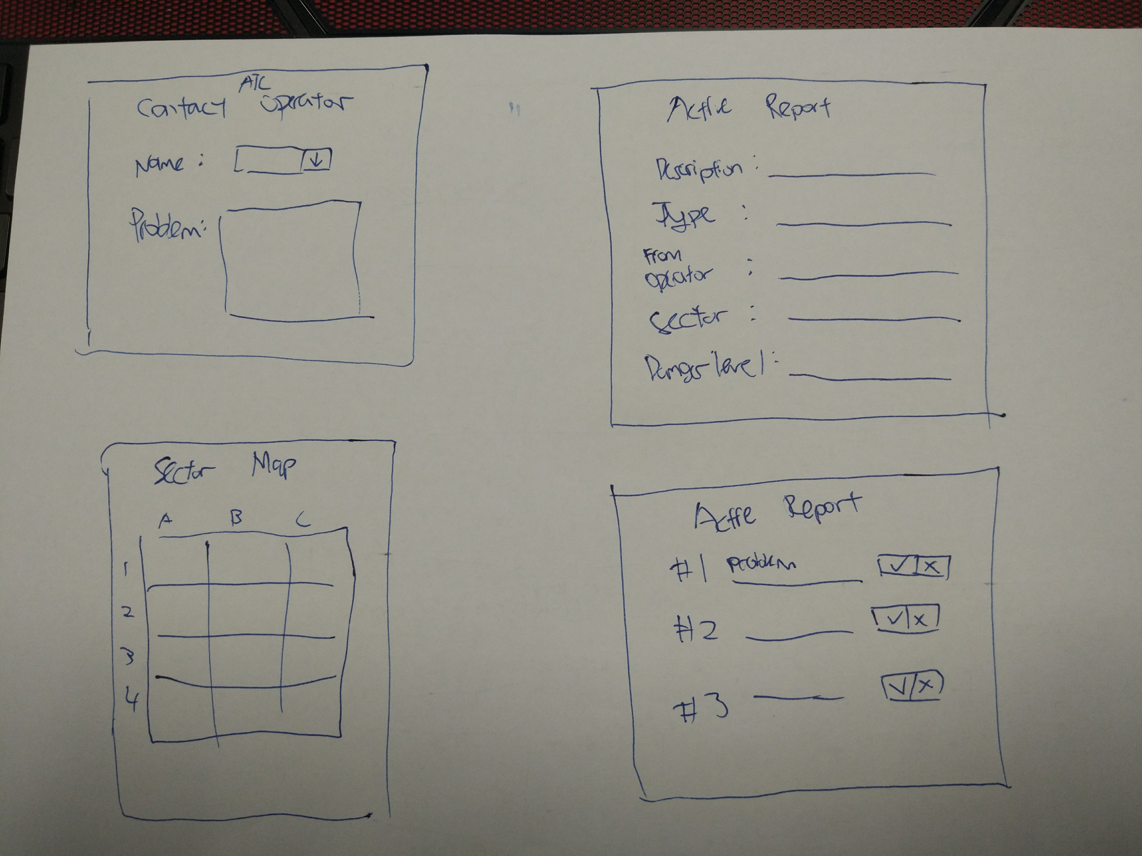
Sketch 8 ideas within 5 minutes – Brandon (2)
The top left sketch shows a screen that allows the user to contact an ATC operator directly, informing him of a problem that might have arisen.
The top right sketch shows the information of an active report, allowing the user to gain more detail towards solving the problem
The bottom left sketch shows a map of the sector that the user can bring up as a quick reference.
The bottom right sketch shows another take on the list of active reports, showing the problems and a checking box to report if a solution has been implemented.

Slide 35
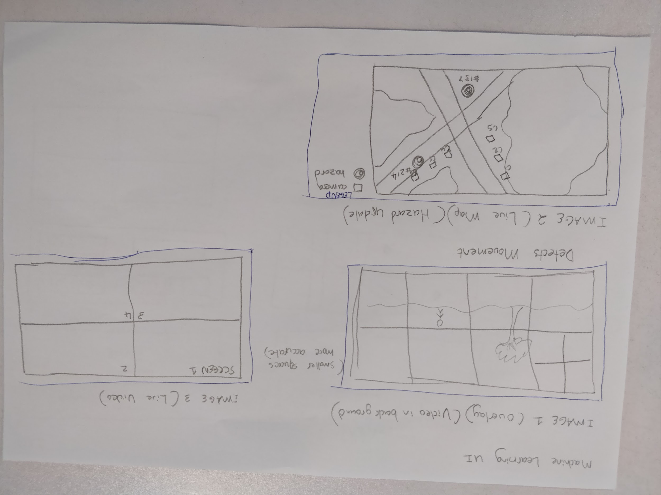
Sketch 8 ideas within 5 minutes – Constant
The sketch depicts the UI for the phone counterpart software which is used on computers.
Image one is how the machine learning algorithm finds objects which are moving or which fit the criteria of being a hazard.
Image two is a live map of instances of hazards being reported by the software, and the code assigned to them, and the severity.
Image 3 shows the live feed of the cameras, as this can be used to also see where hazards are being picked up. This software will be used by the air controll staff.

Slide 36
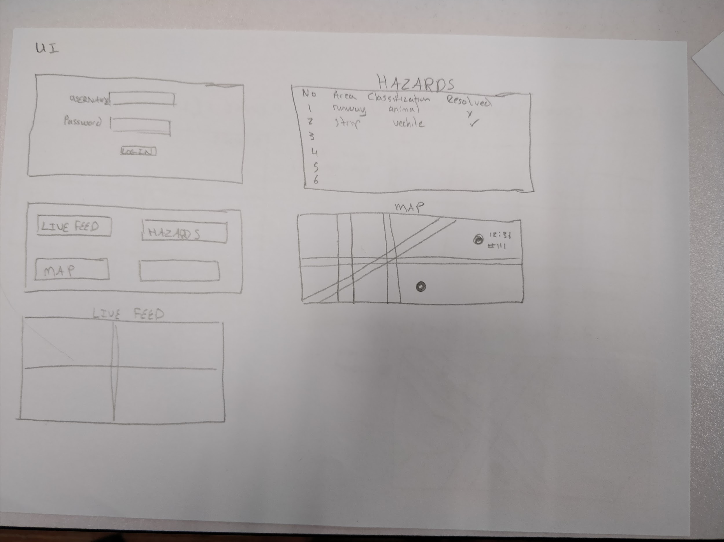
Sketch 8 ideas within 5 minutes – Constant (2)
The android application which will be used in conjunction with the pc counterpart. First image shows the login screen for the users to be able to receive the relevant data assigned to their profile. Screen 2 is the menu you are sent to once login is successful. If live feed is clicked the user is taken to a lve display of cameras. Screen 3 is which hazards have been reported and if they have been resolved and the nature of these hazards. Screen 4 is a live map for the staff to be able to navigate to the hazard areas, and simply click the hazard once resolved. This submits a report back to the ATC software.

Slide 37
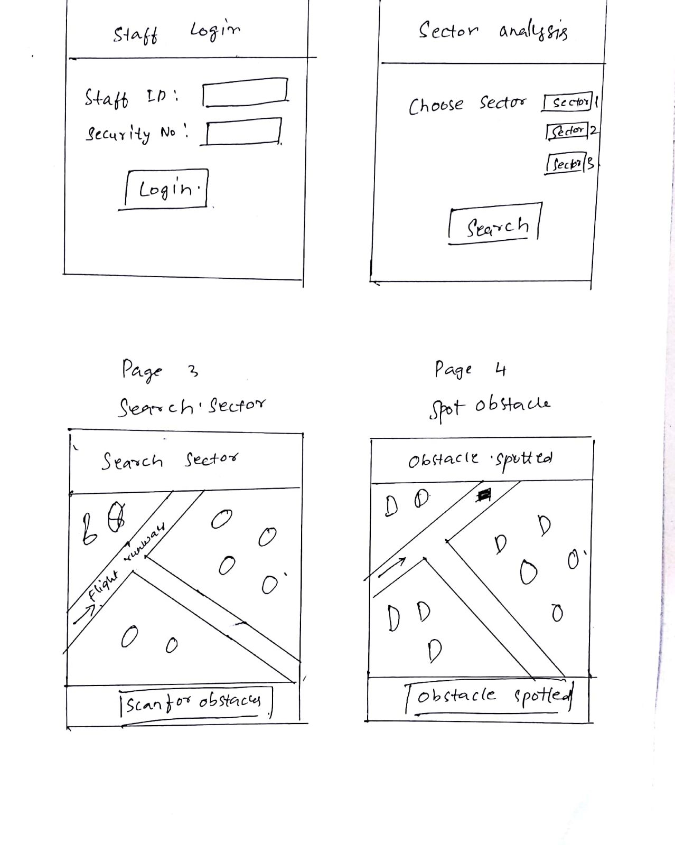
Sketch 8 ideas within 5 minutes – Uday
The first page allows the user to login into his account with his staff id and a unique security number
The second page allows the use an option to select a sector to search the area
The third page will show a map and display an option to scan for any obstacles on it
The fourth page with highlight the obstacle identified on the map.

Slide 38
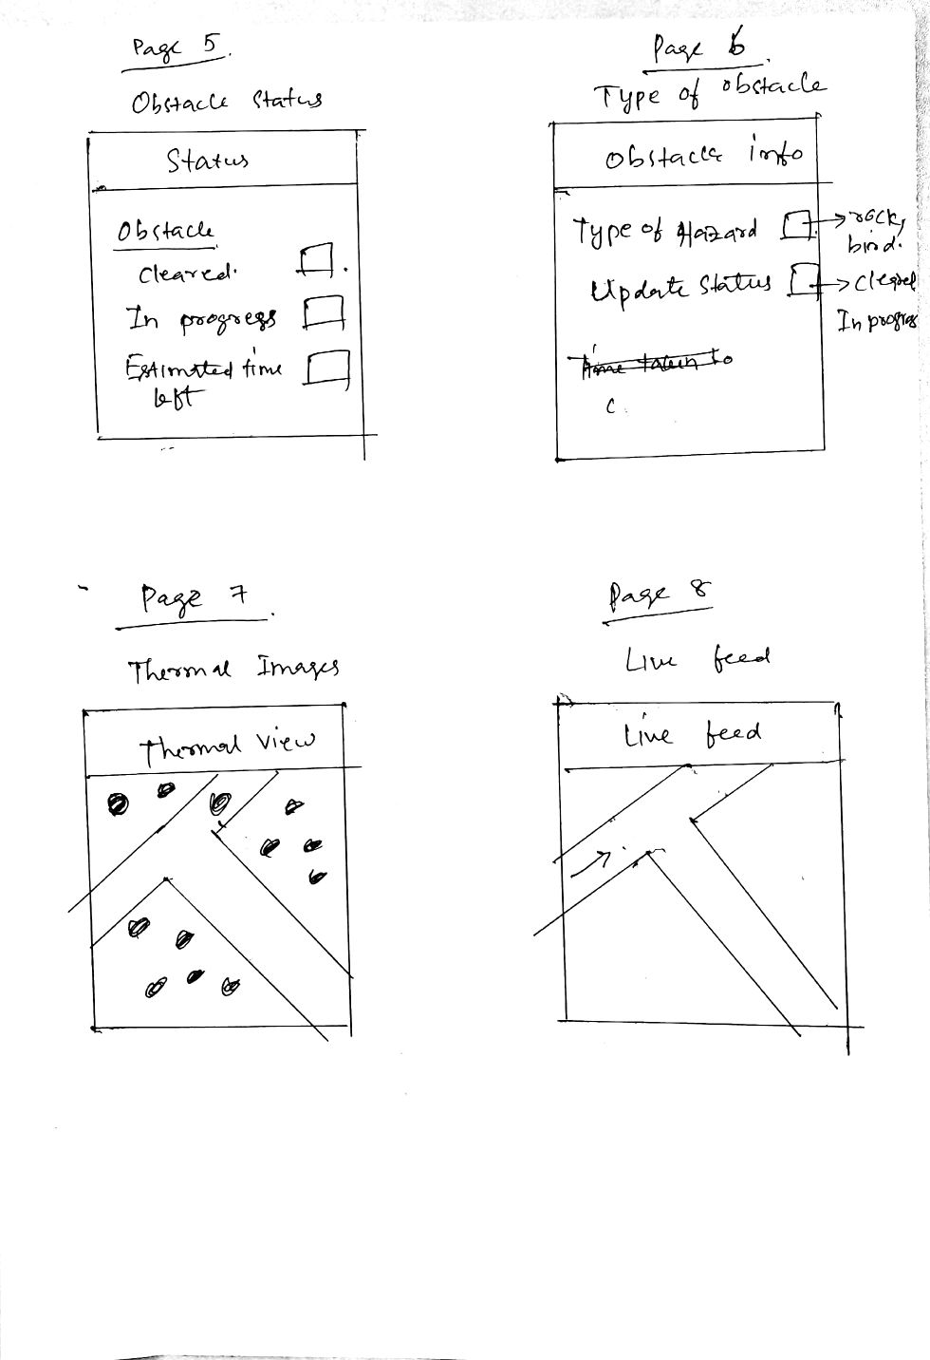
Sketch 8 ideas within 5 minutes – Uday (2)
Page 5 allows the staff to update the status of the obstacle - cleared, In progress and the time left.
Page 6 allows to input the type of hazard identified along with the clearing status.
Page 7 gives a thermal view of the sector.
Page 8 gives the live feed of the sector.

Slide 39
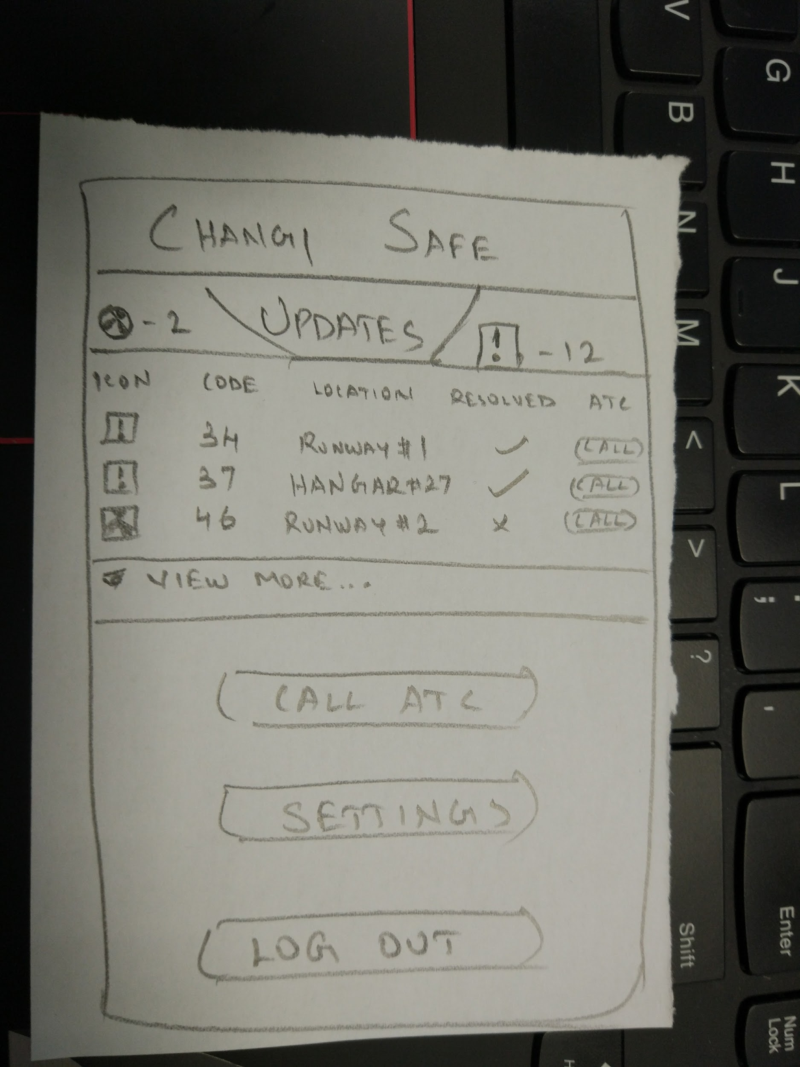
Improve on 1 idea within 5 minutes – Sandeep
This revised sketch is a new proposal of the main menu of the Staff application. I had received critique from my team pertaining to the urgency of notifications that the ground crew would need to access.
Therefore, I have made the updates more prominent to reflect this. To improve further, I have replaced the camera button with that of an instant contact button directed at the ATC tower itself to report crisis situations.

Slide 40
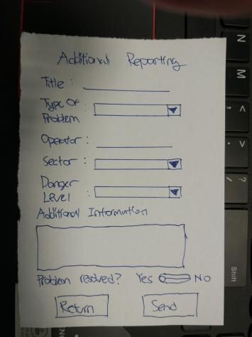
Improve on 1 idea within 5 minutes – Brandon
Upon reviewing the criticisms from fellow teammates, more details were added to the ‘Additional Reporting’ screen, allowing the user to better describe the problem.
A custom text field is also added to allow for a better description if the problem that has arisen does not fit into any of the given fields.
Lastly, the user will be given the options to send or return to the main screen.

Slide 41
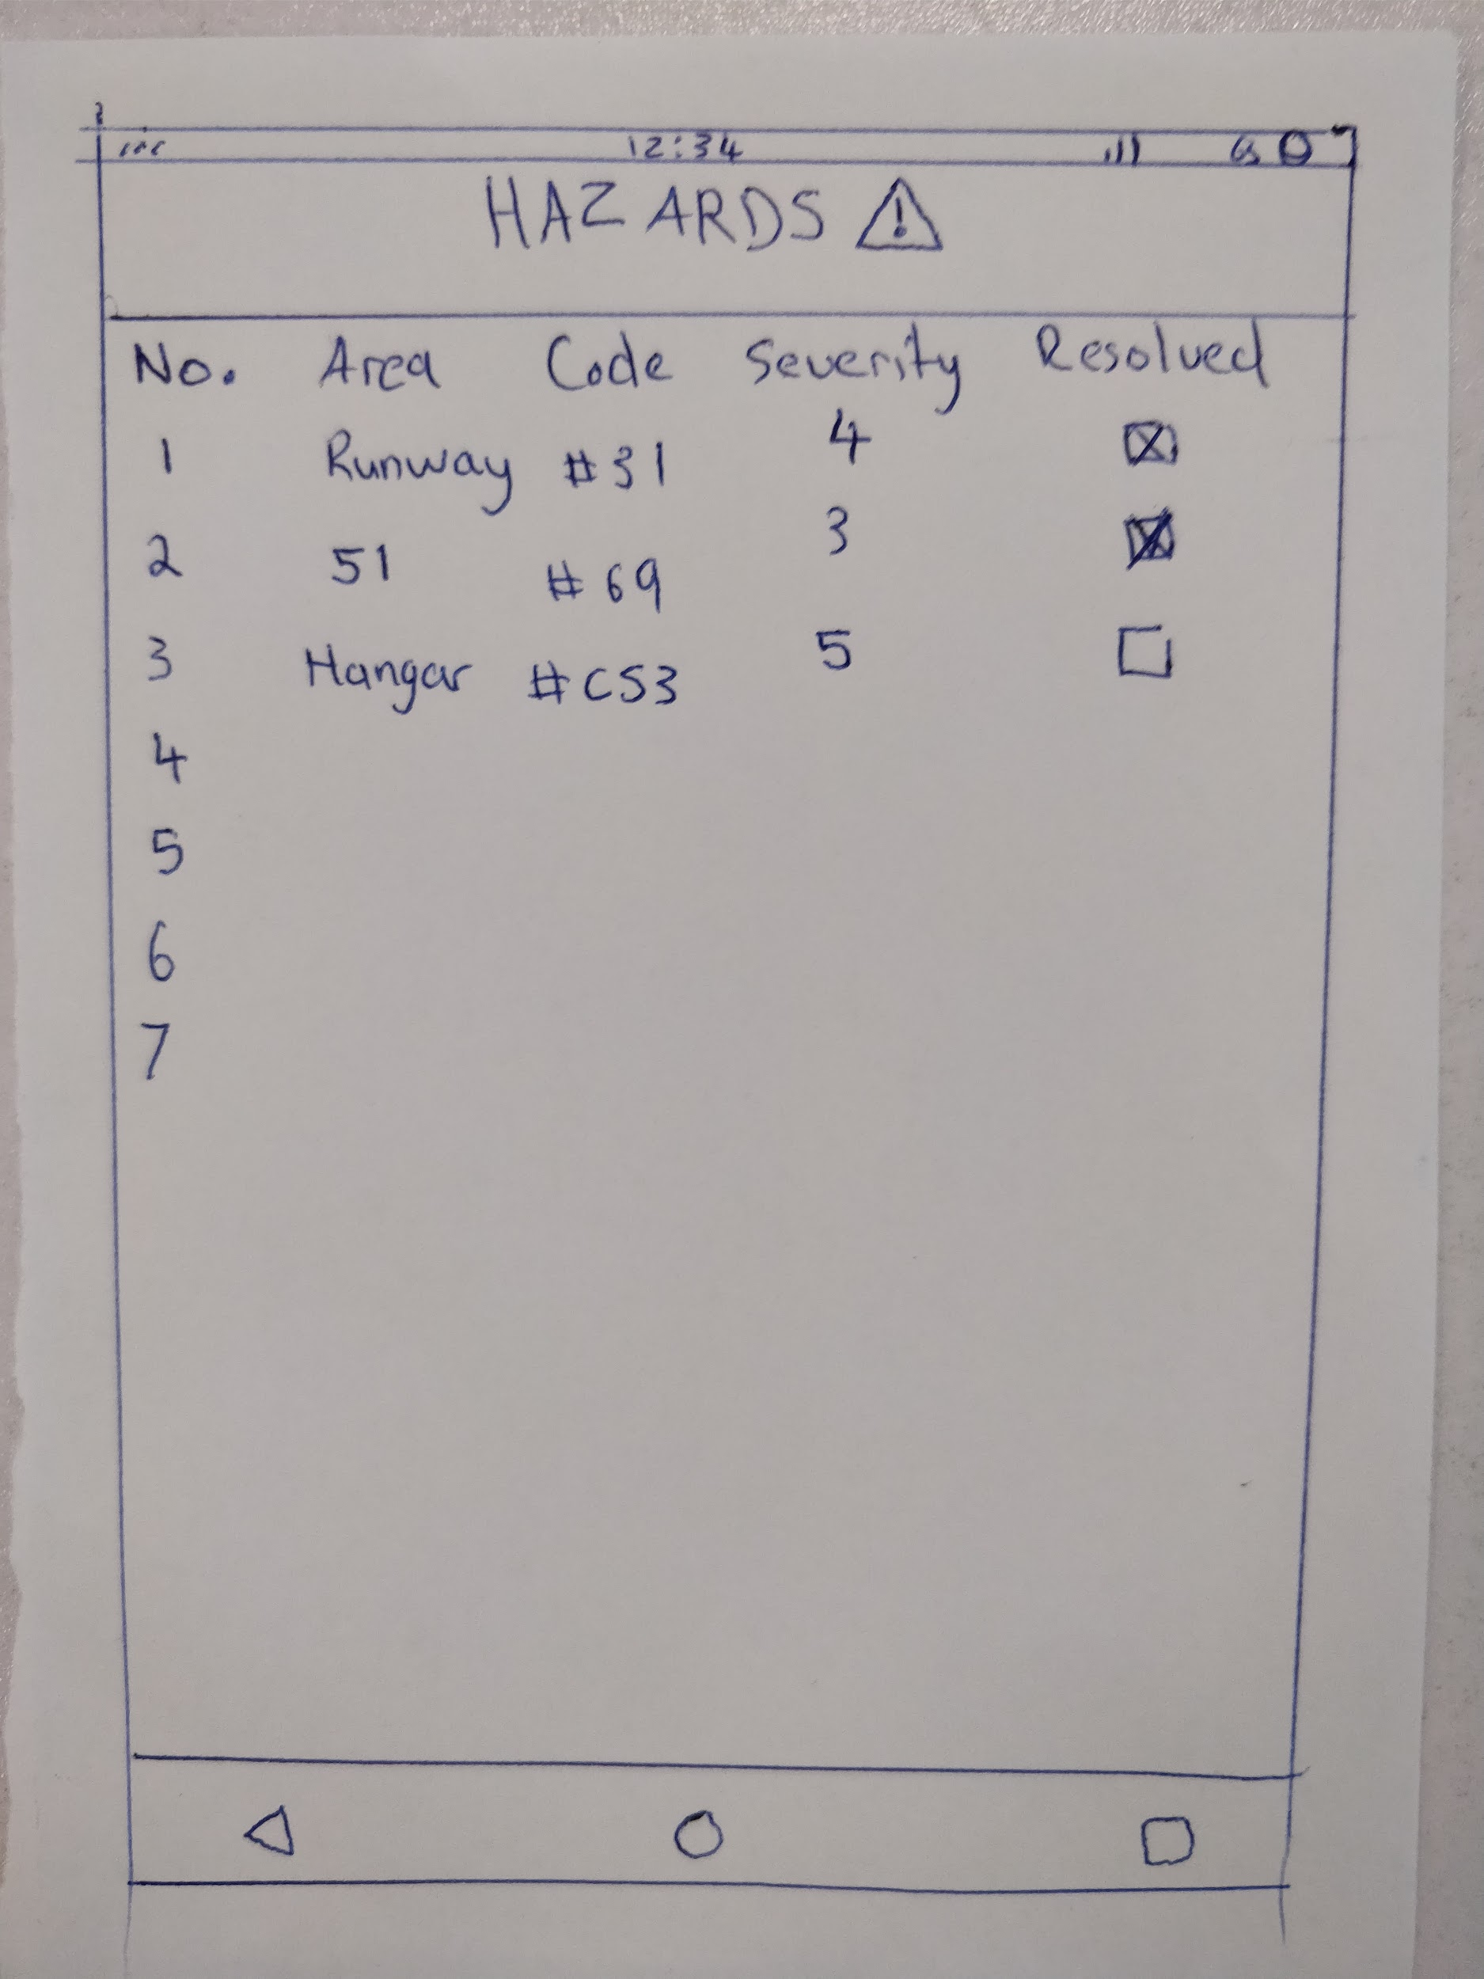
Improve on 1 idea within 5 minutes – Constant
The previous iteration of the Hazards page had
very little features and was not descriptive enough.
In order to improve on this a new layout was used. The method of resolving an issue was changed to just a tick box for easier confirmation.
Code was used to quickly describe the issue at hand, and severity column was added to clearly alert people to how urgent the issue is.

Slide 42
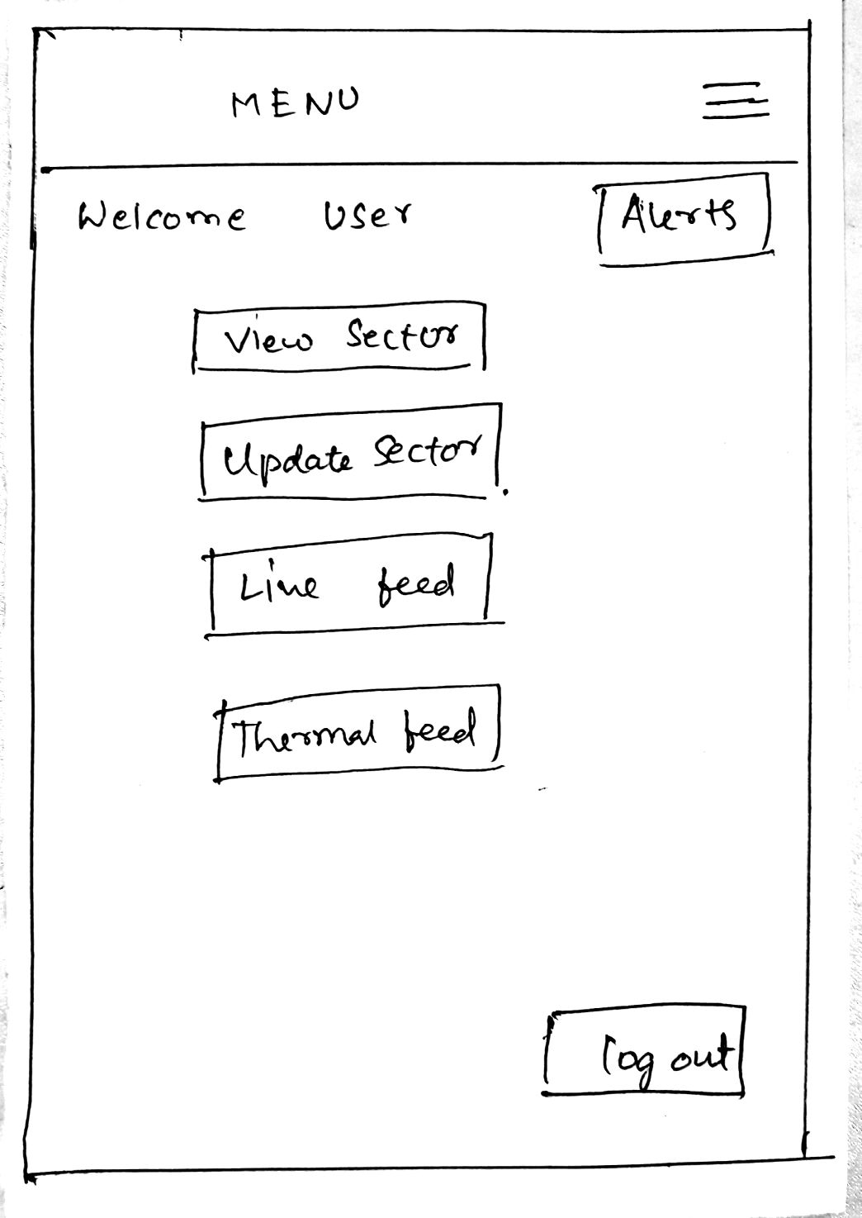
Improve on 1 idea within 5 minutes – Uday
The initial design was missing a coherent page that will supplement all the features in the application. This was implemented using the menu page.
The menu button can be incorporated at the top of each page for easy access.
The page allows the user a one click access to the live feed, thermal feed and also check and update the object status.
The page also contains an alerts option that notifies the user of any emergent issues.

Slide 43
Understand
Reflect
Diverge
Test
Day 1
Converge
Day 2
Prototype
Reflect
Test
Prototype

Slide 44
Converge Methods
Zen voting
Thinking hats

Slide 45
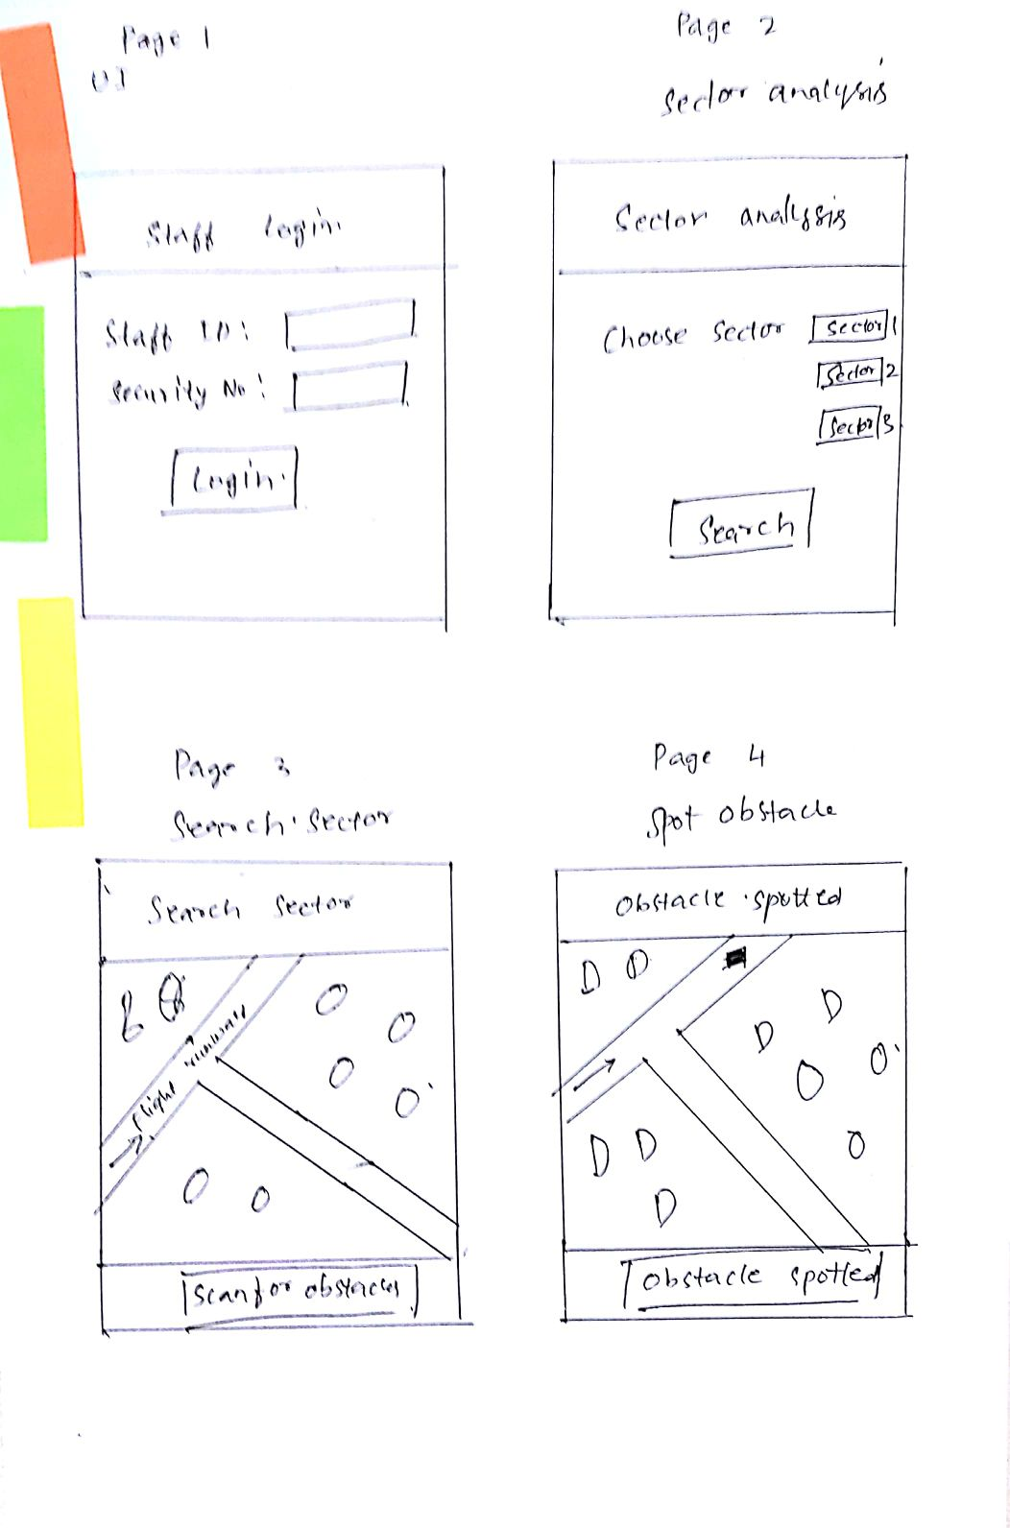
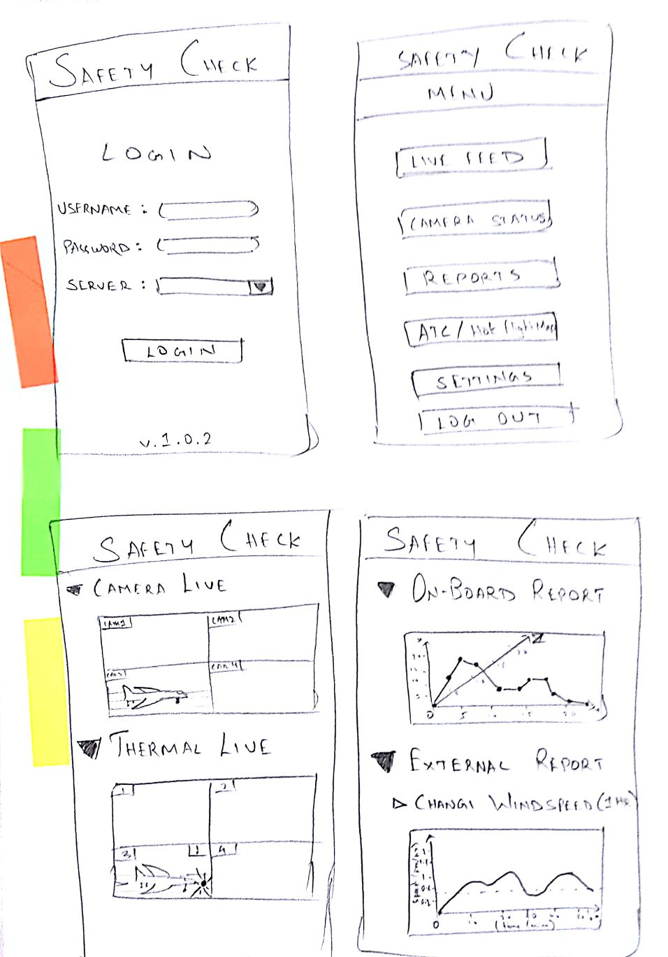
Zen voting
Our team conducted the Zen voting process to select the two best sketches to be developed into paper prototypes by allocating each member two votes that could be distributed to any of the sketches.
The results of this zen vote are displayed on either side of this slide, with one of Uday’s and Sandeep’s sketches being the final chosen two ones.

Slide 46
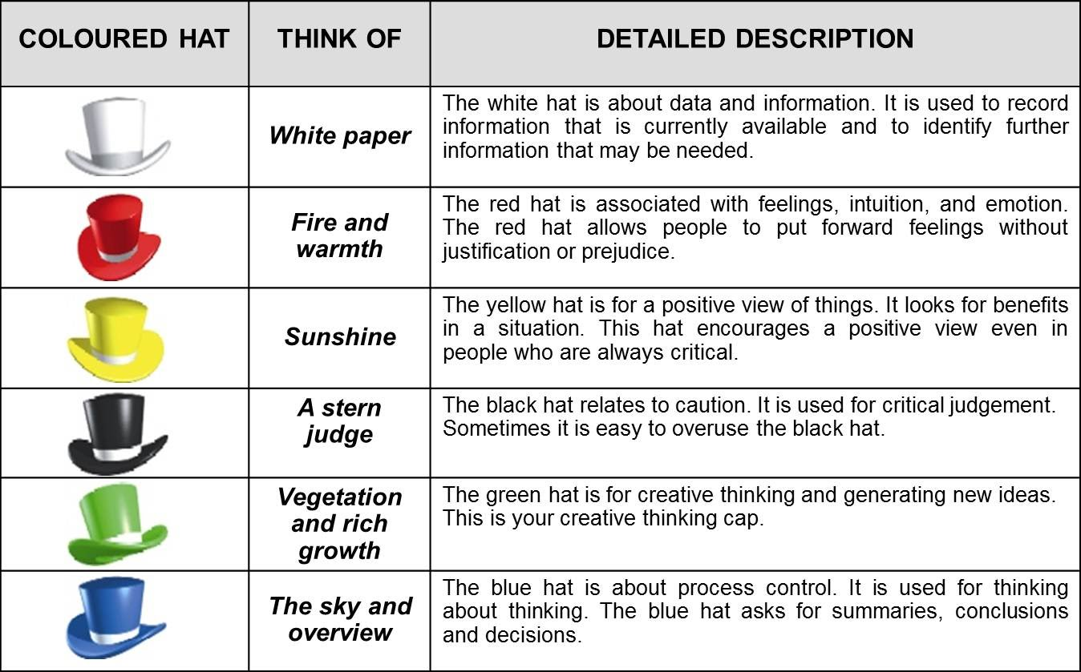
Thinking hats
Name | Role
Sandeep | Green Hat
Brandon | Black Hat
Constant | White Hat
Uday | Yellow Hat

Slide 47
Thinking Hat process for Sandeep’s sketch

Slide 48
Thinking hats - Sandeep: Green Hat
Although the sketch depicts the information overflow concept in a broad manner, creative elements could be introduced to improve the thematic quality and navigation of the prototype.
One of the revisions that can be attempted would be the display of the camera live feeds and live reporting. Since our team aims to run this on a static ATC workstation equipped with multiple screens to monitor multiple feeds at once, they can be compounded into one frame with the ‘swipe’ feature of mobile phones being used extensively to navigate between their individual elements.
Further creative changes could include a menu rework to make several important tabs appear more prominently, with the others stacked away on another side-swipe screen. And although clear and decisive terminology is required for admin use, icons can be added to tabs and buttons to improve user readability.

Slide 49
Thinking hats - Uday: Yellow Hat
The sketch incorporates a graphical element into the design. We can compare the statistics based on on-board and external reports and get an easy overview of the current happenings. This will allow for a quick safety check analysis.
Camera views on multiple screens is critical in identifying the obstacles at a moment’s glance. The thermal sensor viewing adds an extra element to this visual design.
A coherent and easy UI that incorporates similar elements within the same page. We can see these elements applied to represent the graphical reports and camera feeds.
Cohesion can further be observed by the detailings on the menu page. This page allows for a quick navigational option to the user.

Slide 50
Thinking hats - Constant: White Hat
In order for this venture to work correctly specific sets of data and information will be needed. The data collected will mostly come from the video recording devices installed. This raw data will be analysed by a machine learning algorithm and give statistical output. This processed information will then be relayed into certain aspects which can help with predicting hazards, and how to handle hazards on, and around the airfield space.
Currently information needed are live feeds of the footage being captured by the cameras. Included with this raw footage is an option for thermal imaging which will help when there are weather alerts. Both the video and thermal need to work in conjunction with another so that the switch between the 2 are flawless. Both methods are monitored constantly by the algorithm.
The party that will benefit the most of the data is the air control center(ATC) once the camera data is processed and fed to the appropriate system this sector will then pass the information to the ground staff, they will handle the hazard, or hazard to be.
The login feature uses pre existing data to verify the user who is using the software. This data is captured and logged for when staff rotation comes into place. Data is also captured from incoming and outgoing flights to ensure that all data is synced across all platforms and that the airport can function in sync.

Slide 51
Thinking hats - Brandon: Black Hat
The purpose of this design is clear, to display as much relevant information to the user, members of the service crew. However, there might be too much unnecessary information displayed in the application.
The presence of the live video and data feeds might not be needed for the users at all. This is because our users will mostly carry out the rectification of the problem, and do not need data such as real time visual of the affected area. A static image will do more than enough, such as taking a picture with the posted camera by the ACT operators when submitting the problem report.
Relating to the main issue with the design, the menu screen might be visually cluttered, and clear call-to-actions are not present. Implementation of appropriate colours and fonts might solve this, or better yet, a streamlined menu that only displays the relevant details that the users should be concerned about would do better.
Notes:
Overall, the proposed screens are decent for an initial build. However, each of the screens can be improved on. The title of the application does not have to be displayed with each screen; The users of the application are definitely going to be authorised personnel working at the airport.
The First screen, the Login page, is good, with minimal clutter and only displaying the required information.
The Menu screen looks appropriate as well, although the layout of the buttons can be improved. It has to be intuitive for the user, and the current layout of the buttons might prove confusing to potential users. As a landing page, it can be implemented as suggested for now, but should be improved upon user feedback.
The third screen with the live image feed is not needed, as the application serves to relay specific information to the service crew. The visual information might help, but will be better served for the ACT operators to inspect and pass judgement. Having a live feed might also slow the application down, or drain the device’s battery. The service crew might just need images of the suspected or ongoing problem, rather than wasting resources showing a live feed.
The last screen also shares the problems of the live video feed screen. The information is not needed for the service crew, and would be better for the ACT operators to review and act on it.

Slide 52
Thinking Hat process for Uday’s sketch

Slide 53
Thinking hats - Sandeep: Green Hat
The design of this prototype is clean and streamlined to provide our features accurately without much clutter.
A prominent creative aspect of this sketch would be the live sector map, that is updated in real-time with events that are being tracked by the ATC and the ground crew. This bird’s eye view provides the user with the information in the best comprehensible format.
Some elements of this sketch that could be innovated to be more creative include the select sector page. The layout and options in this page seem misaligned and chaotic in nature, when compared to rest of the pages of the sketch.

Slide 54
Thinking hats - Constant: White Hat
The staff side of the application requires other sets of data to correctly pass relevant information to the governing party.
The staff version relies heavily on a live map that is critically updated with hazard information. This graphical representation seeks information from the parallel computer application which places alerts on the live map for the ground staff. From this data visualisation actions can be taken to avert disasters. The requested information is then classified. This data should be stored on a database for later access and analysis.

Slide 55
Thinking hats - Uday: Yellow Hat
The sketches highlight the importance of using map based features rather than textual content. This allows for the identification of an obstacle on the map. The technician can immediately zoom in on the location and spot the obstacle.
The map feature allows for a color-coded scheme to contrast different objects of interest. This will help in differentiating and listing down objects based on their level of awareness. The map can also be filtered based on the selected choices by the user.
The design of these pages is simplistic. It does not contain an overload of information that will confuse the user while using the application. The buttons are highlighted as clickable buttons and the call to action is easily noticeable.

Slide 56
Thinking hats - Brandon: Black Hat
This design is more streamlined in delivering the relevant information to the users. However, there might be too many buttons for the user to click to access important information.
The application does not fit the intended solution. It attempts to tap into the available sensors to scan for problem areas, rather than relaying messages from the ACT operators, who are the ones that have full access and are capable of deciding the problem areas.
Notes:
Overall, the proposed screens are decent for an initial build. However, each of the screens can be improved on. The title of the application does not have to be displayed with each screen; The users of the application are definitely going to be authorised personnel working at the airport.
The First screen, the Login page, is good, with minimal clutter and only displaying the required information.
The Menu screen looks appropriate as well, although the layout of the buttons can be improved. It has to be intuitive for the user, and the current layout of the buttons might prove confusing to potential users. As a landing page, it can be implemented as suggested for now, but should be improved upon user feedback.
The third screen with the live image feed is not needed, as the application serves to relay specific information to the service crew. The visual information might help, but will be better served for the ACT operators to inspect and pass judgement. Having a live feed might also slow the application down, or drain the device’s battery. The service crew might just need images of the suspected or ongoing problem, rather than wasting resources showing a live feed.
The last screen also shares the problems of the live video feed screen. The information is not needed for the service crew, and would be better for the ACT operators to review and act on it.

Slide 57
Understand
Reflect
Diverge
Test
Day 1
Converge
Day 2
Prototype
Reflect
Test
Prototype

Slide 58
Design Sprint Daily Reflection – Plus/Delta Approach
Detailing the positives and the changes to be implemented in a table format
+
Time management was utilised to finish tasks with sufficient time for bettering paper prototyping Organization regarding the Thinking Hats and how the information was relayed and used. Team collaboration Interviews Page designs | Refine the paper prototype by adding more features Improve the design aspects Revise document structure Improve on wording and explanations with Personas

Slide 59
Understand
Reflect
Diverge
Test
Day 1
Converge
Day 2
Prototype
Reflect
Test
Prototype

Slide 60
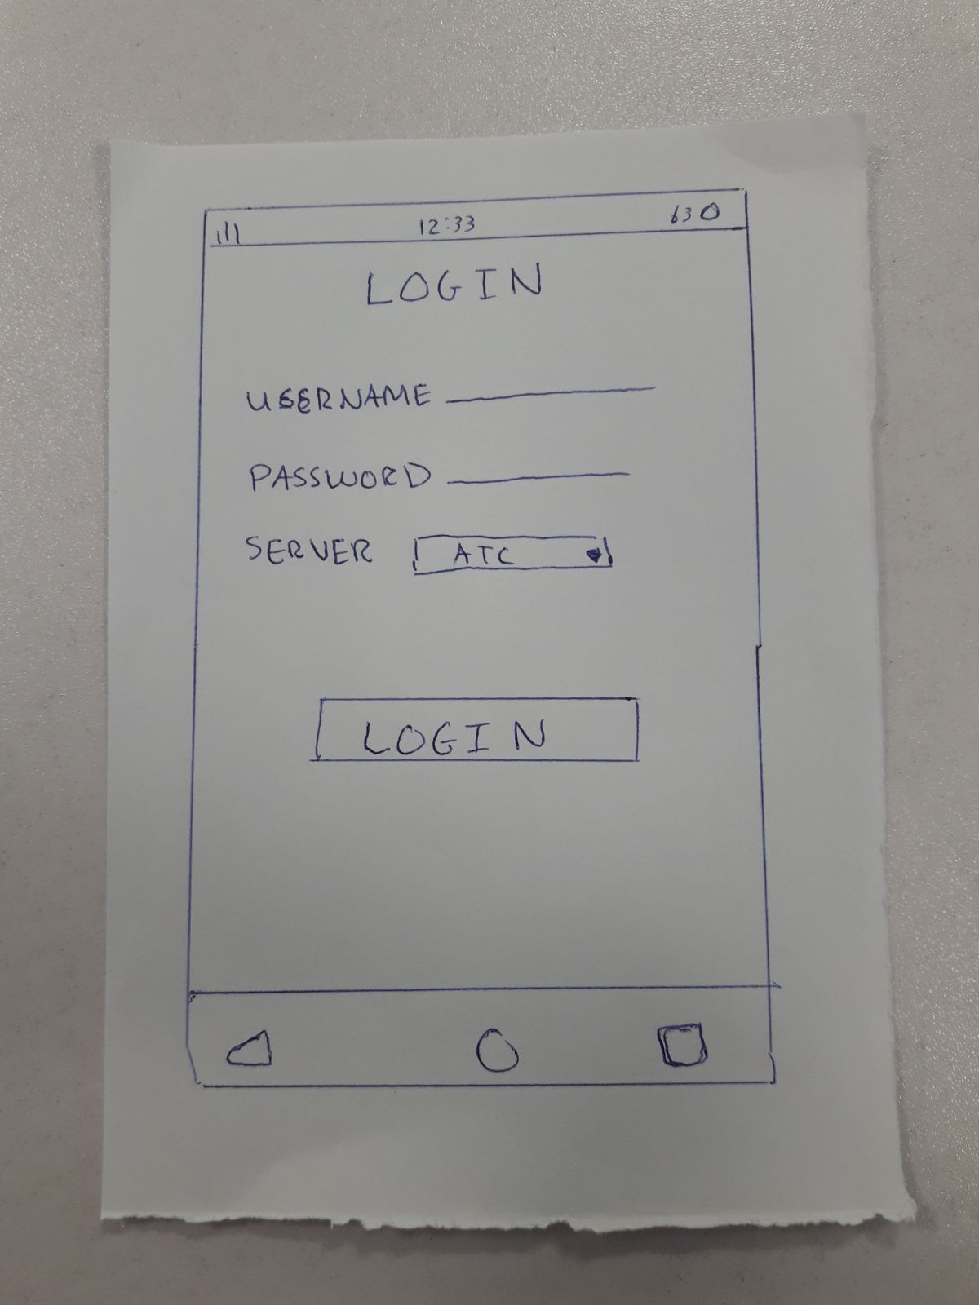
Paper prototype 1
This prototype provides a basic login page functionality to authenticate the user
The user can select a server of his choice to login into
The login feature is highlighted as a clickable button with a larger font size
The footer contains a list of three features that are displayed using icons

Slide 61
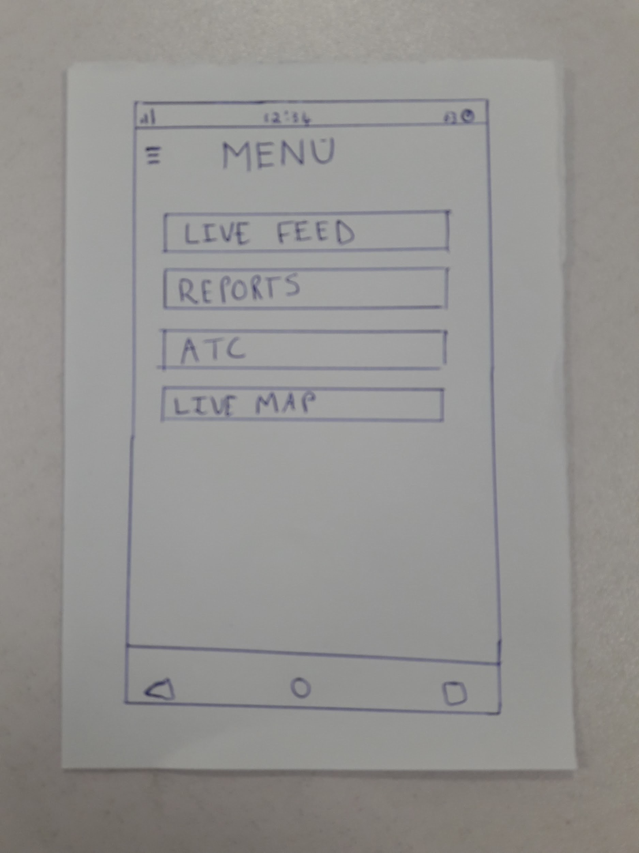
Paper prototype 1 (contd.)
The menu page acts as a centralised theme for this prototype
The page displays a list of user options which are included as clickable buttons
The page allows a quick access to live feed and live map
The user can also access the reports page to update the status of the sector

Slide 62
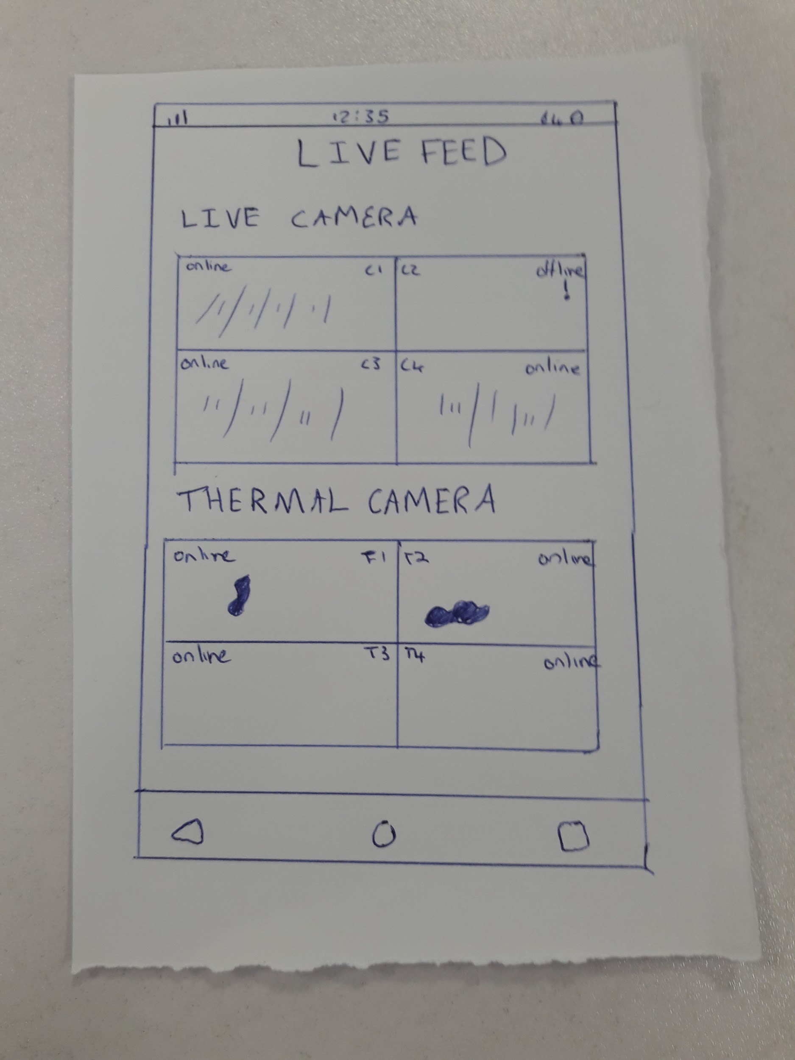
Paper prototype 1 (contd.)
This page has a dual mechanism to access the cameras on the ground
The live camera view displays all the cam views in box format. The user can track the events on the runway in the live mode.
The thermal camera modifies the live view with heat sensors. Objects are highlighted in contrasting colors which helps in quick identification
The user can quickly see the thermal view and match the live feed on the same page

Slide 63
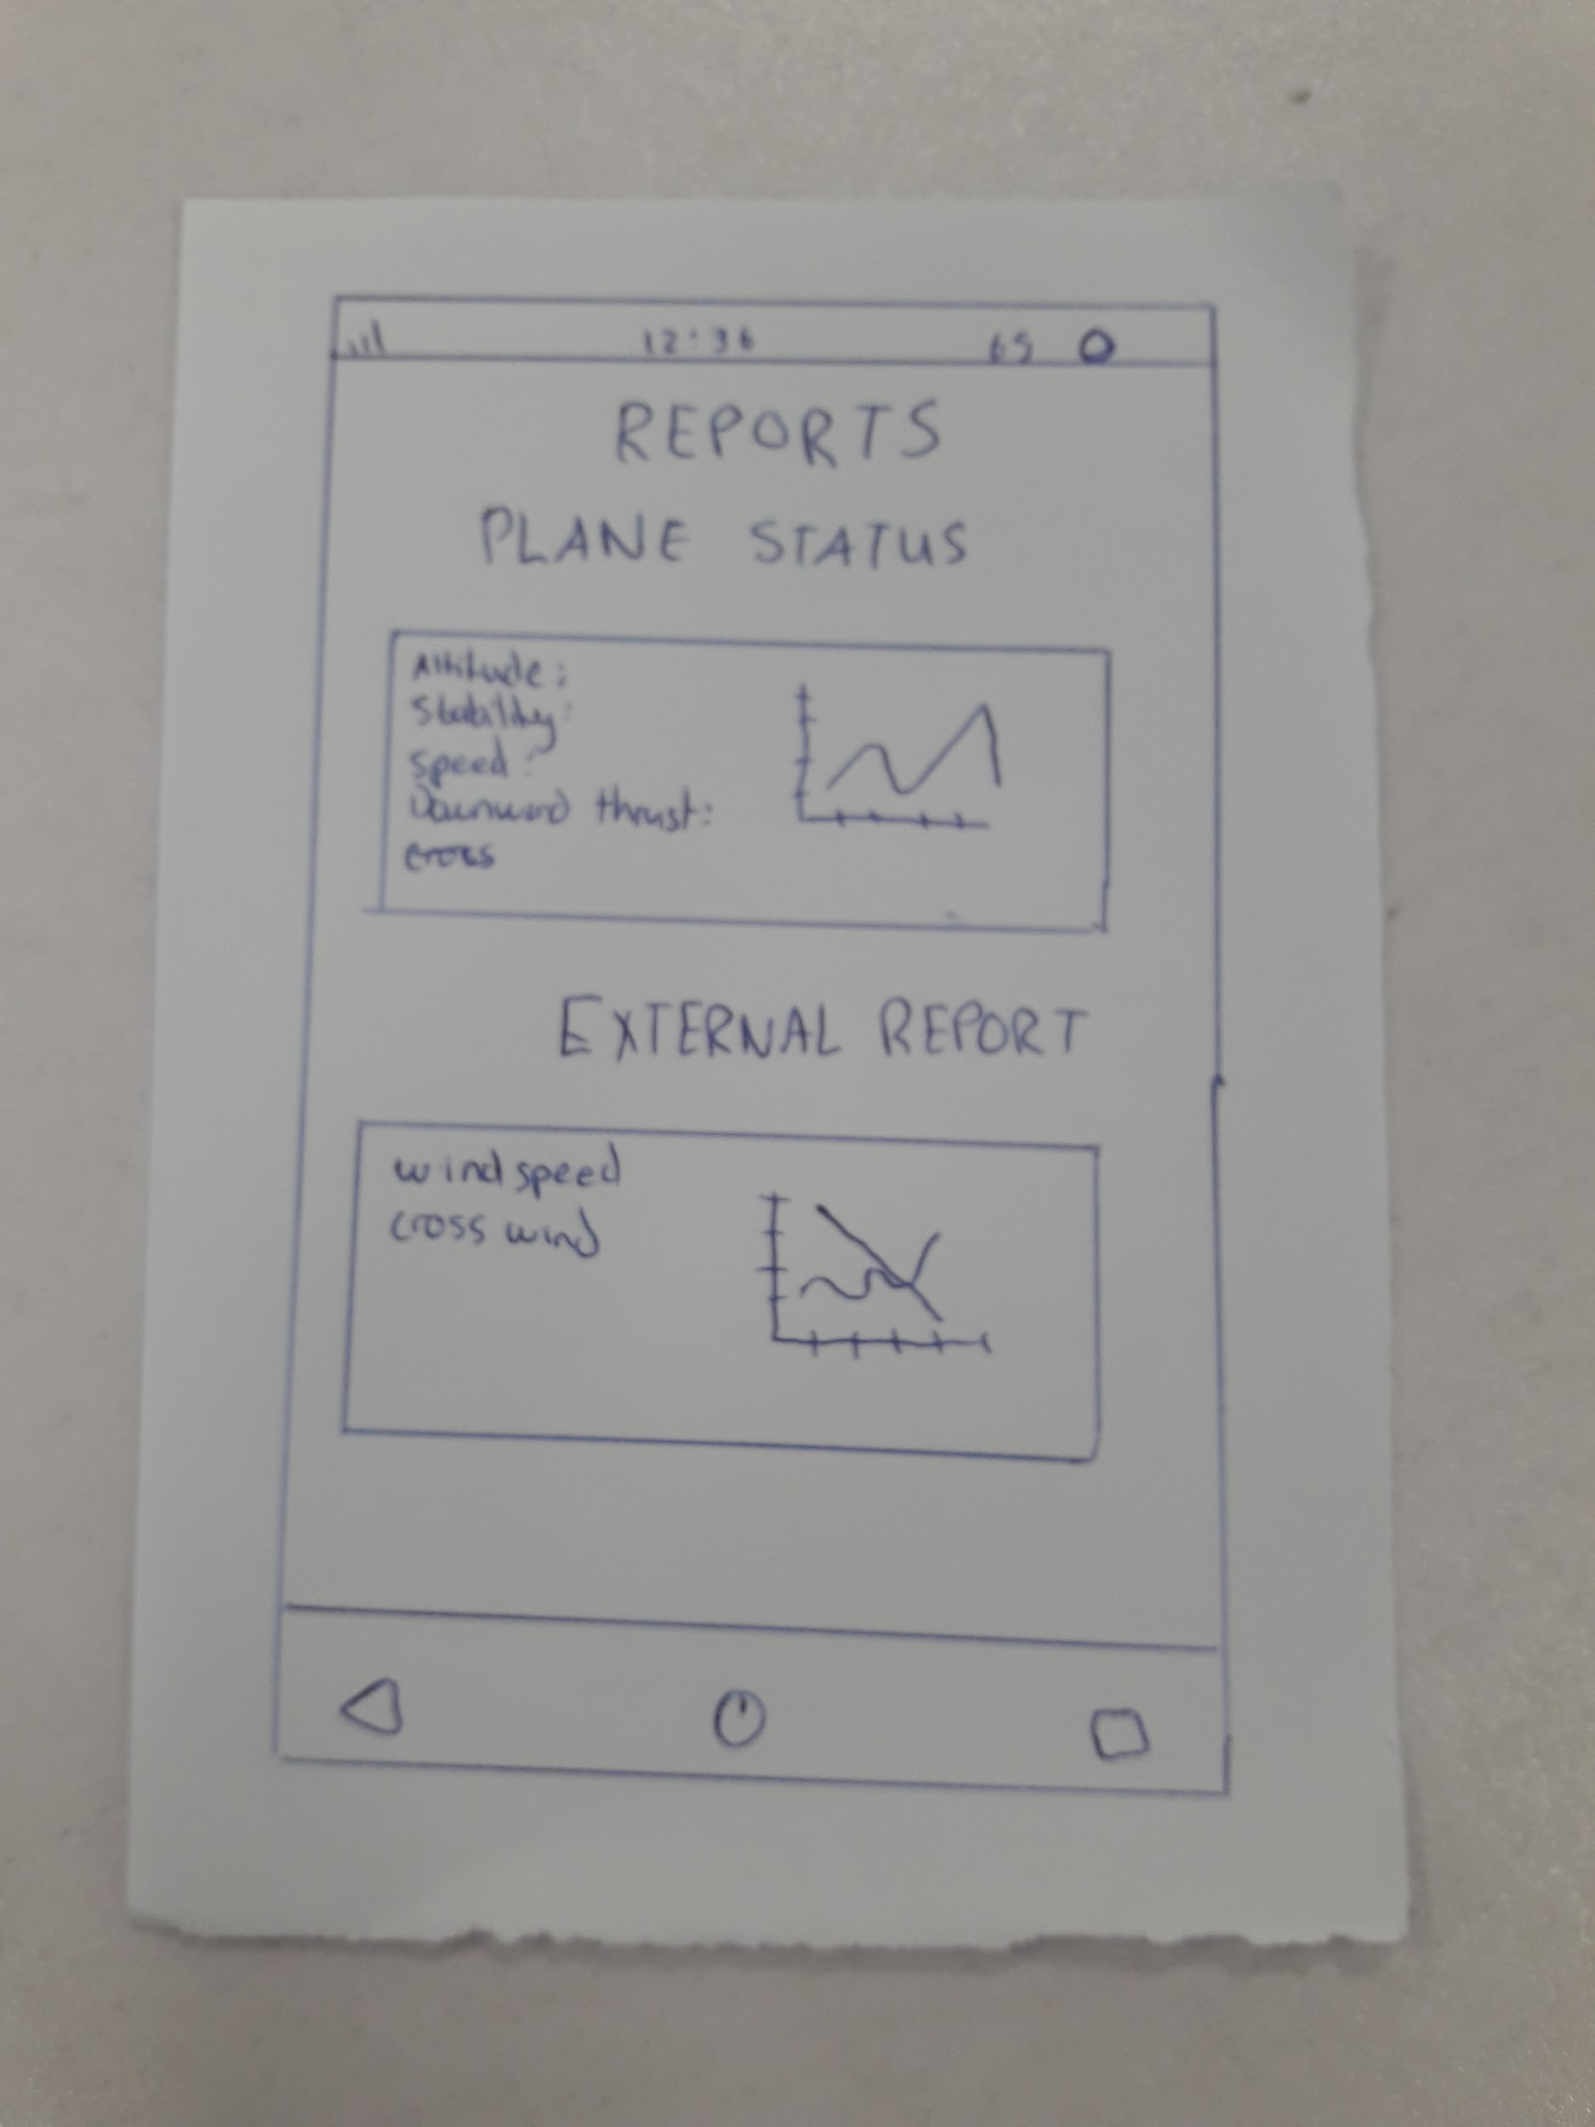
Paper prototype 1 (contd.)
The reports page incorporates a graphical element in the page design.
The user can check the plane status on a graph and detailed description highlighted to its left in a textual format
The user can see the windspeed and contrast it with the crosswind on the graph

Slide 64
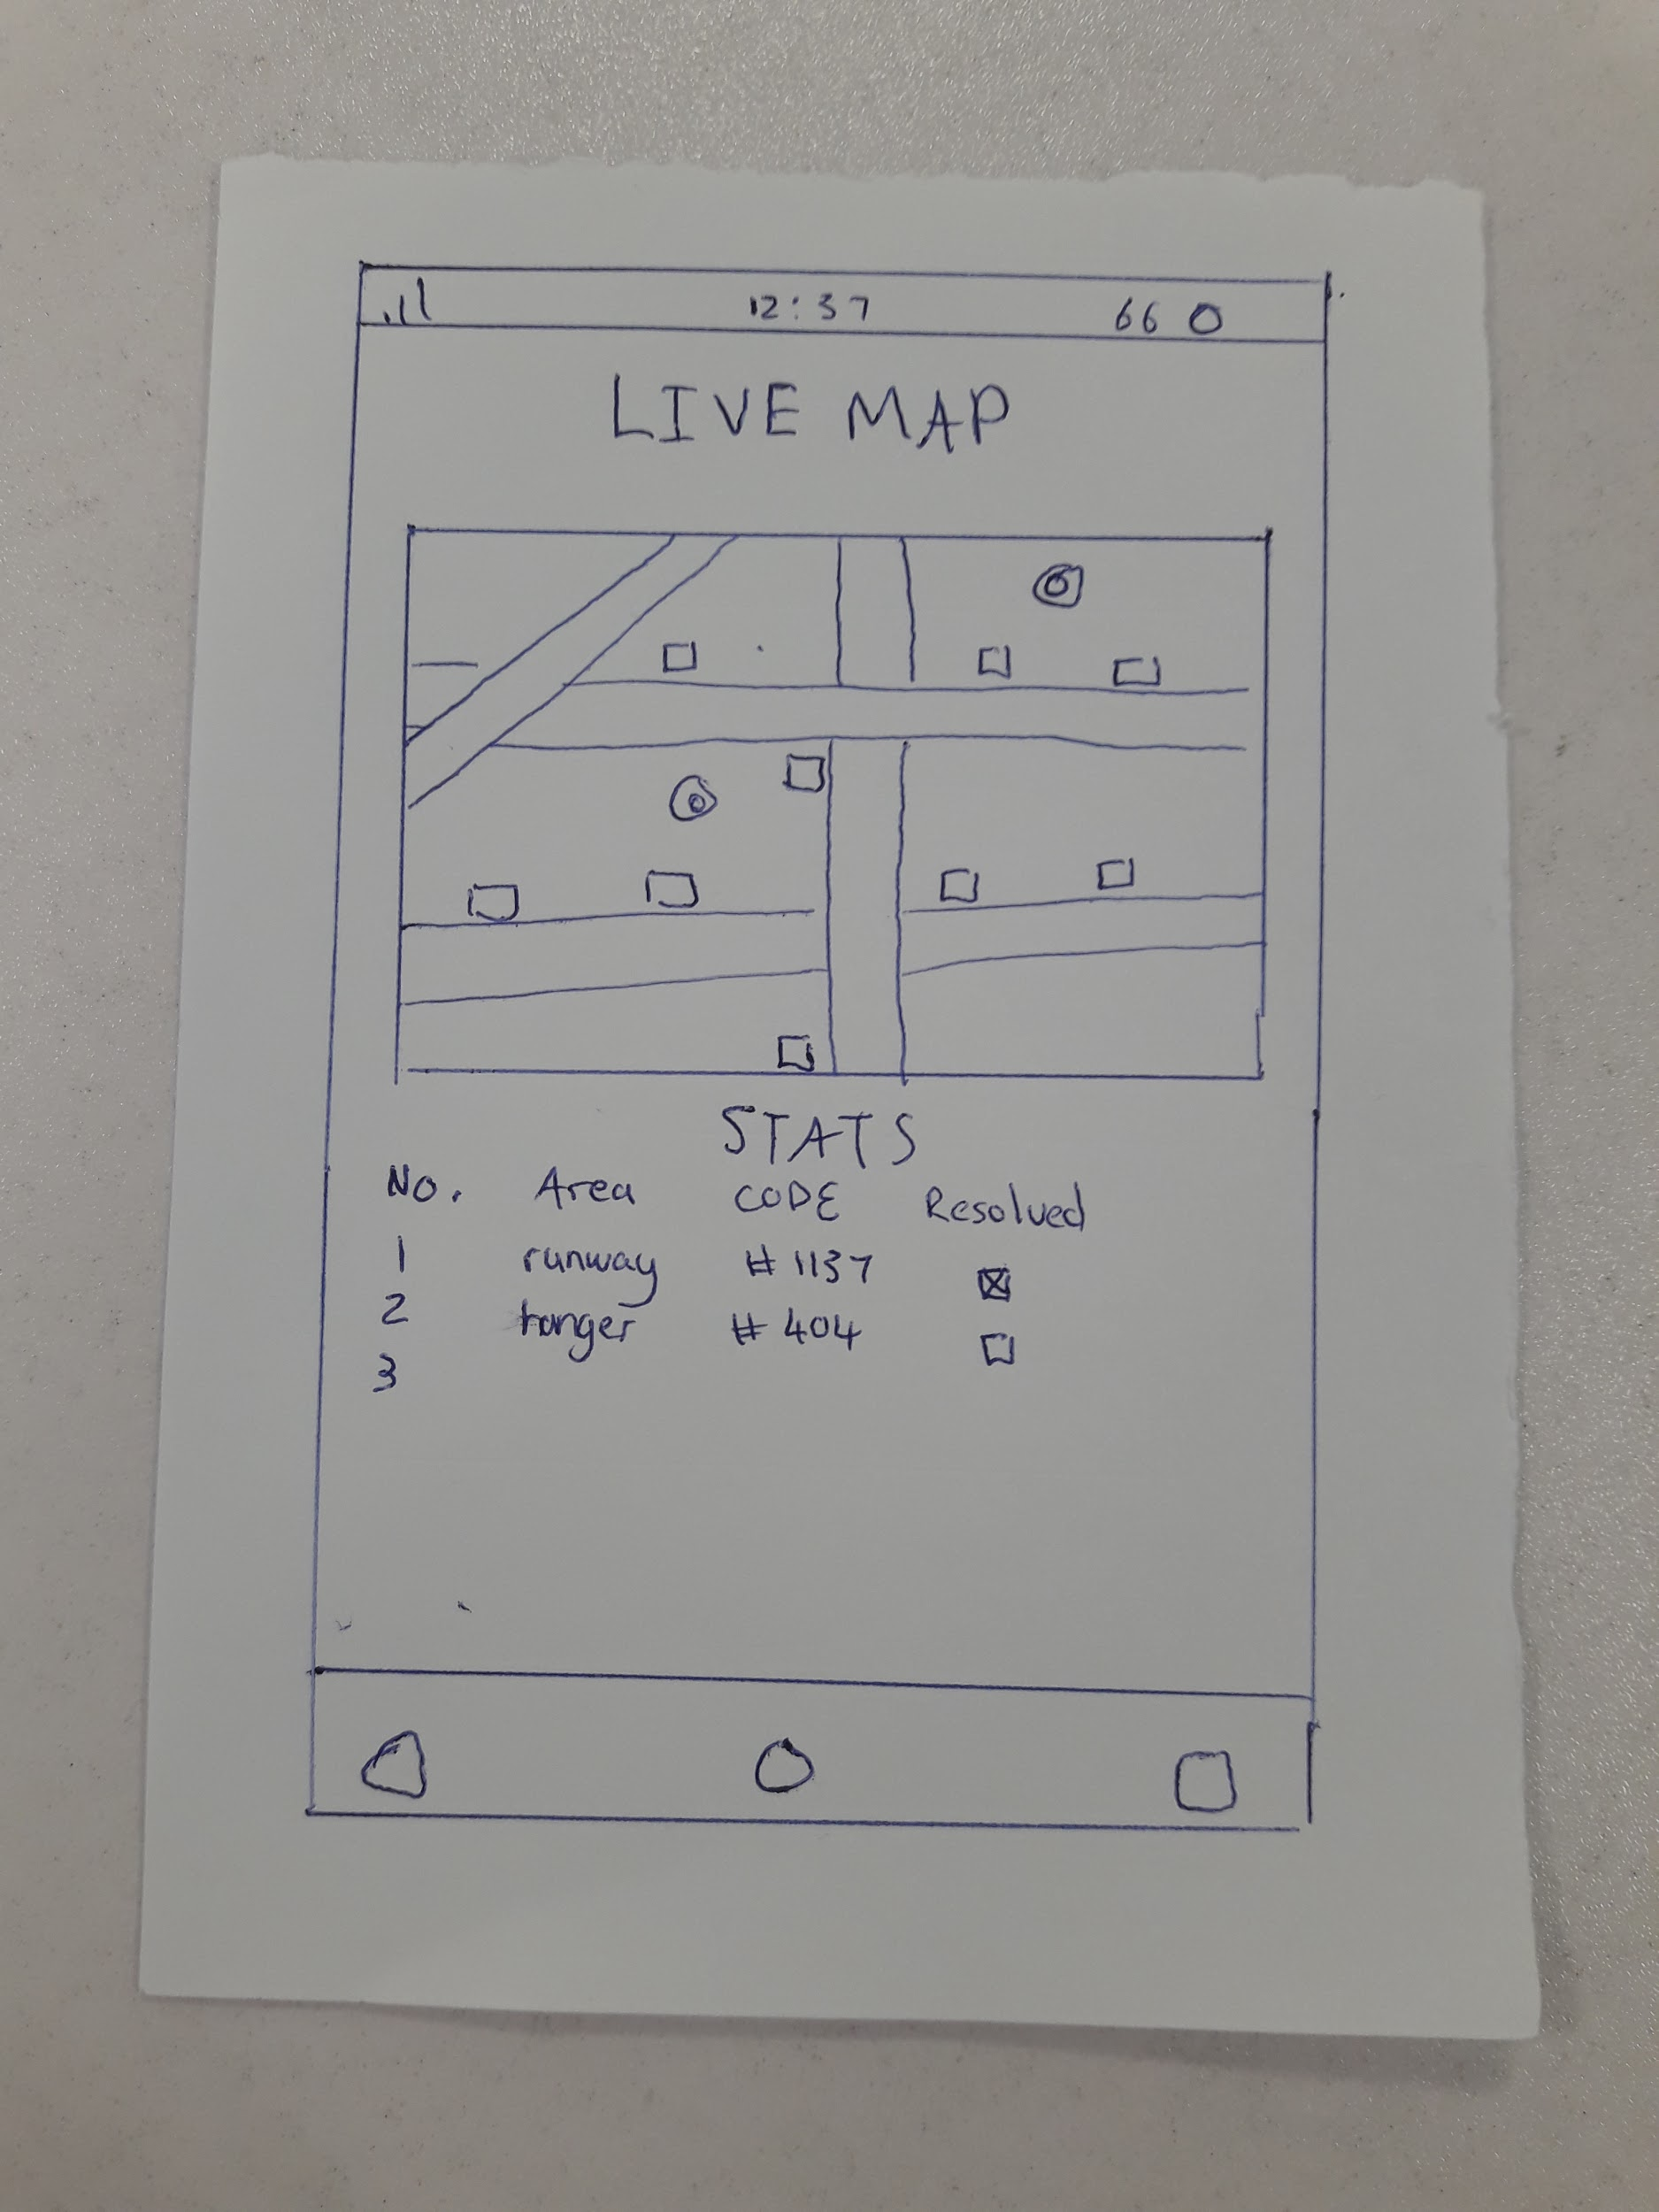
Paper Prototype 1 (contd.)
This page incorporates a map element to the design
The map of the runway is displayed in a box format with identifiable obstacles
The stats are displayed at the bottom of the map with the runway status
The status can be updated to resolved and unresolved using check boxes

Slide 65
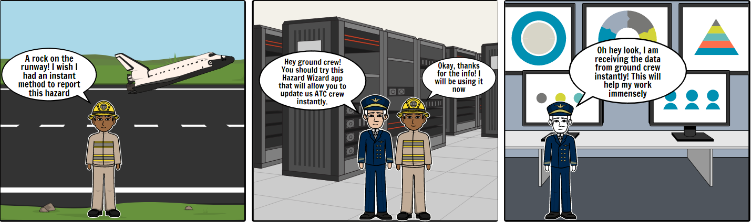
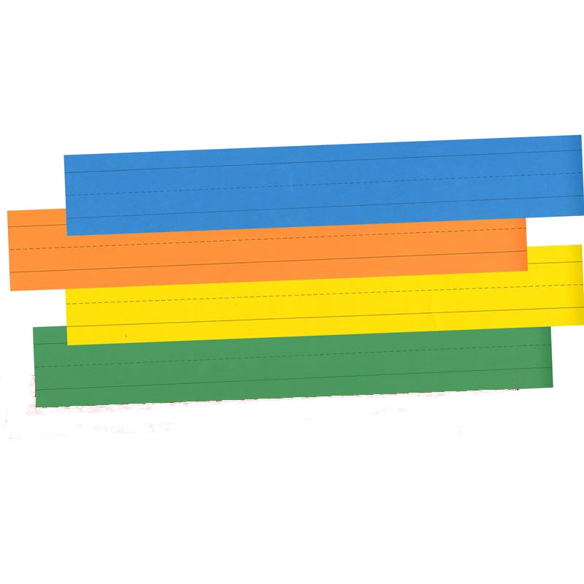
Storyboard 1

Slide 66
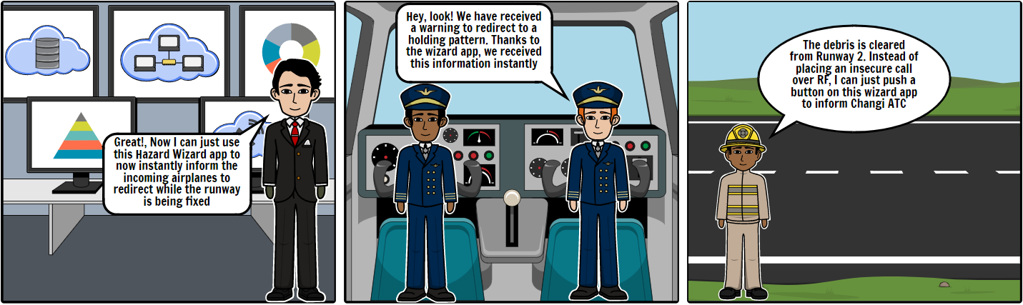
Storyboard 1 (contd.)

Slide 67
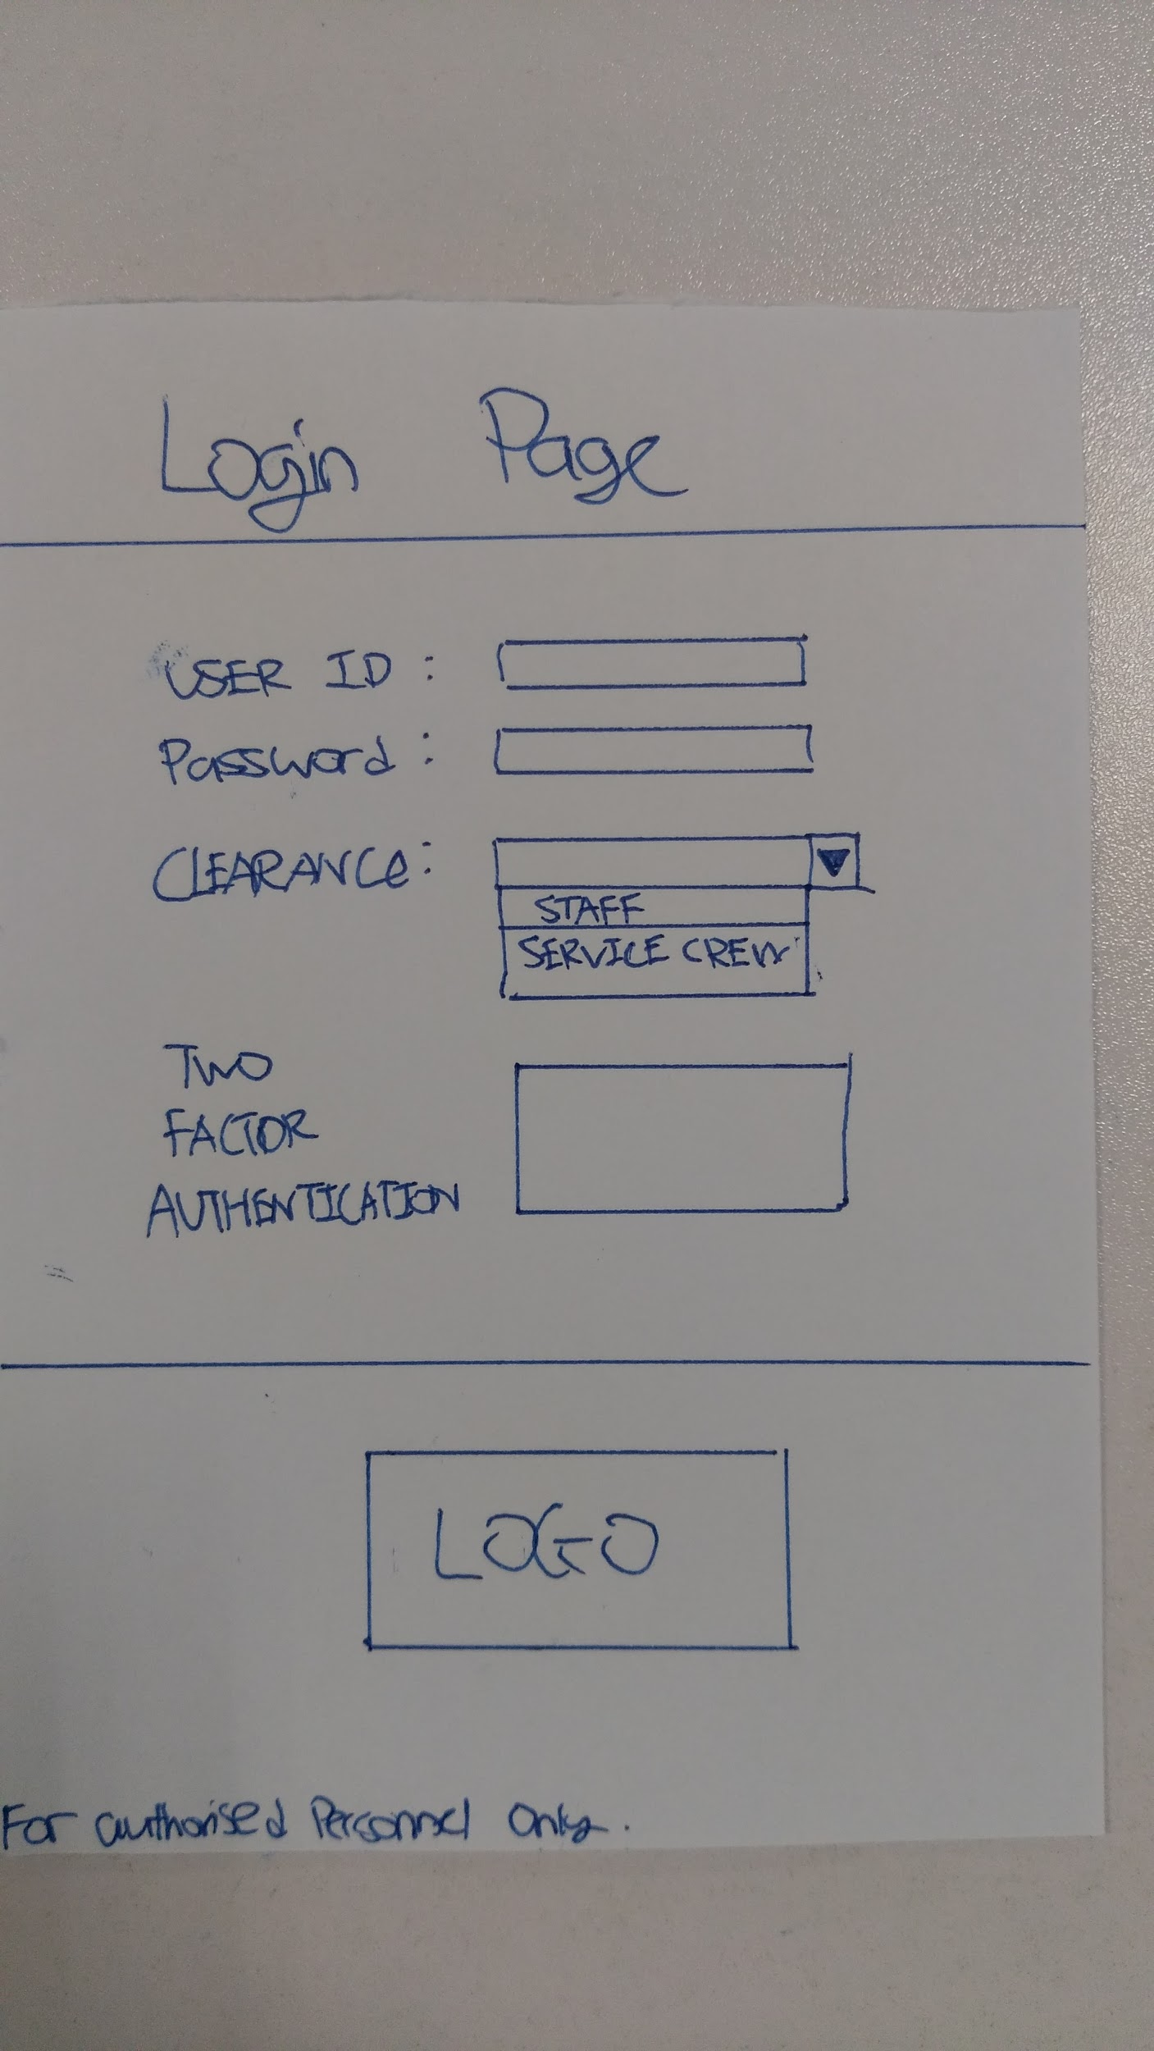
Paper prototype 2
The new login page is modified with extra elements in the page design
The server selection is replaced with the staff clearance option indicating the level of approachability in the app
A two-factor authentication ensures a more secure network
The logo is displayed at the bottom of the screen

Slide 68
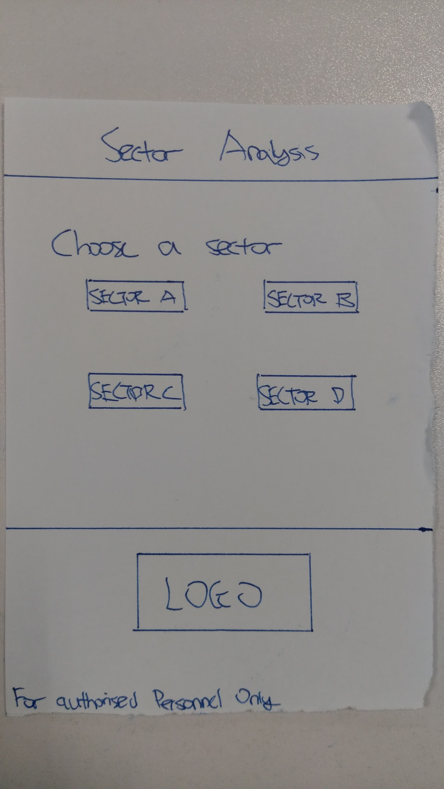
Paper prototype 2 (contd.)
Sector analysis serves as the menu page for this iteration
The user can select the sector area of interest using clickable buttons
The layout is purportedly simplistic to allow quick and easy navigation

Slide 69
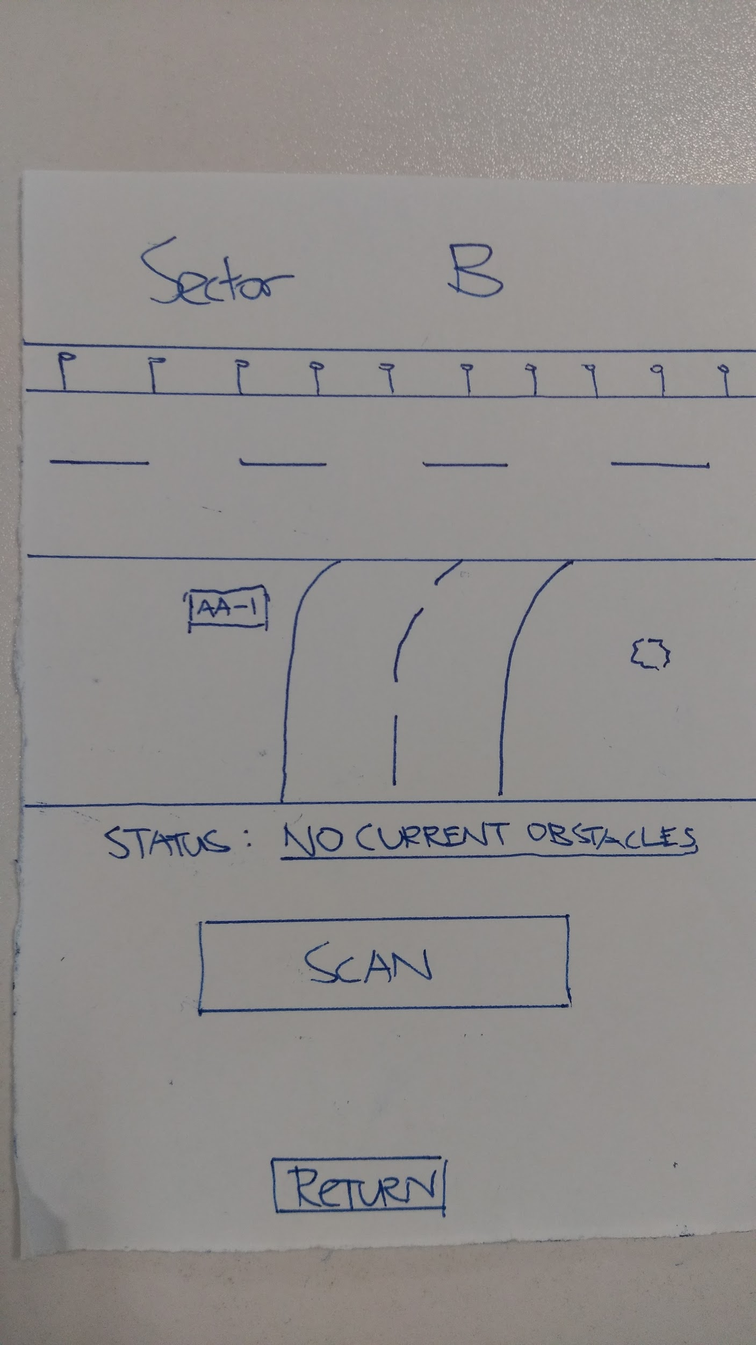
Paper prototype 2 (contd.)
This page displays a map of the runway of the chosen sector
No current obstacles detected is shown as the status on the page
The user can scan the sector for any obstacles using a clickable button
The page also includes a return button that allows the user to go back to the previous page

Slide 70
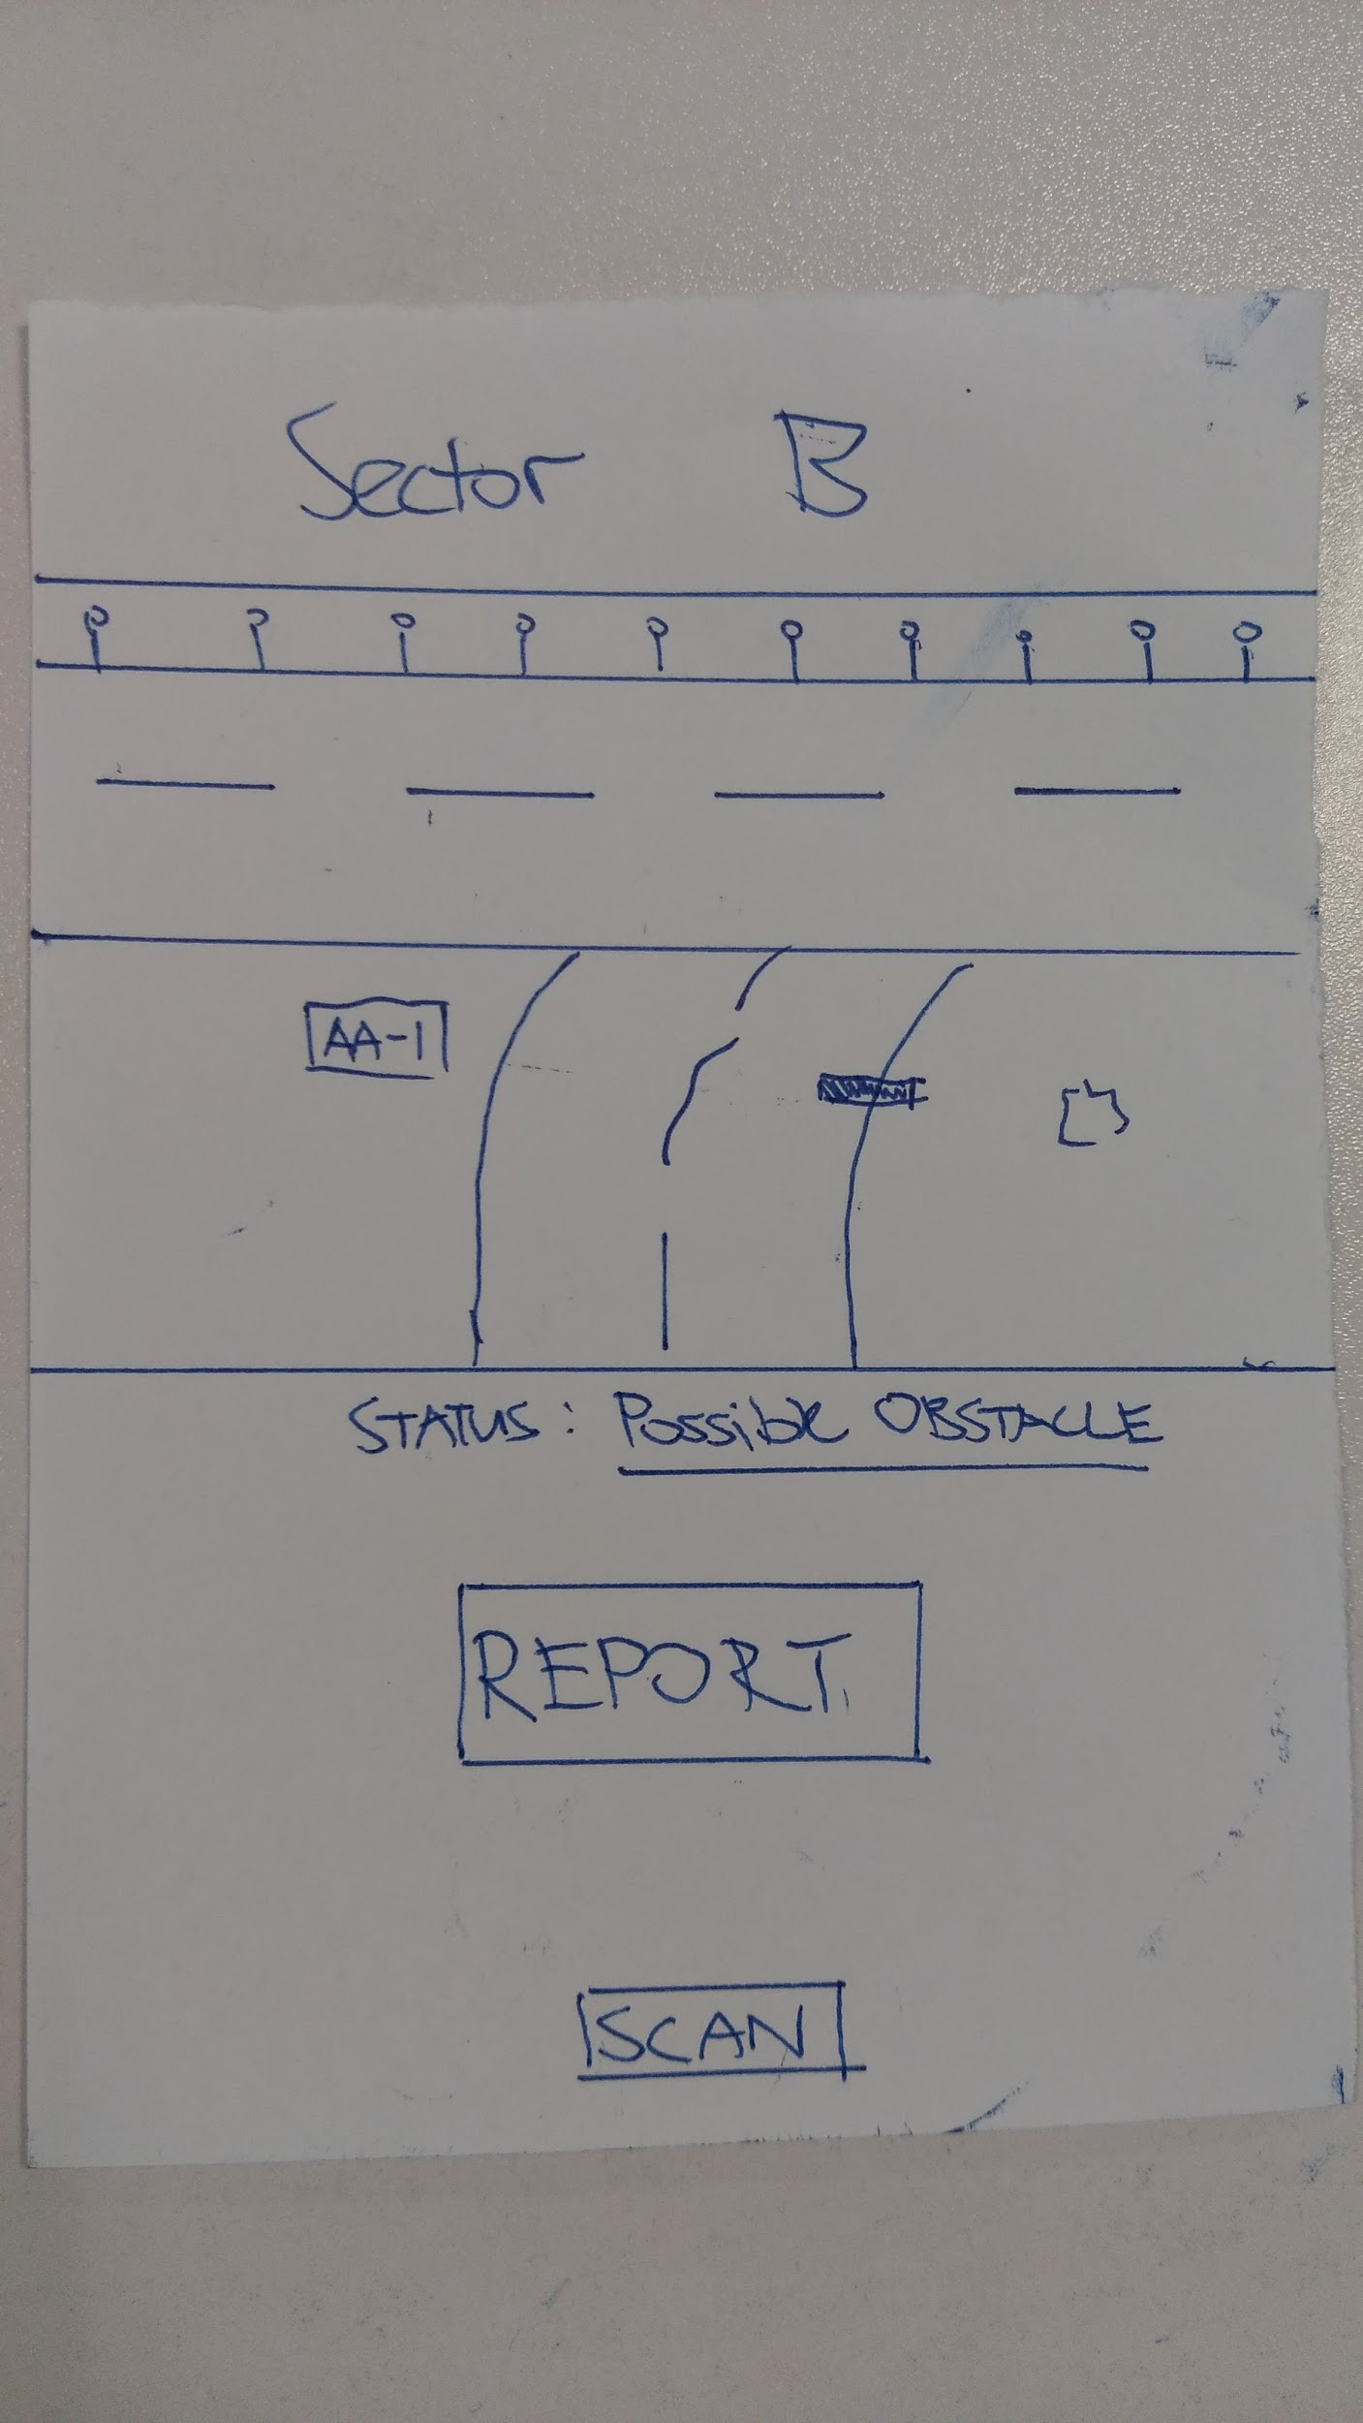
Paper prototype 2 (contd.)
The page displays the runway map with scanned results of the sector
The status is displayed with a possible obstacle highlighted in the text column below the map
The object identified is grayed out on the map in contrasting colors for easy visual reference
A report button is included to generate a report on the obstacle spotted

Slide 71
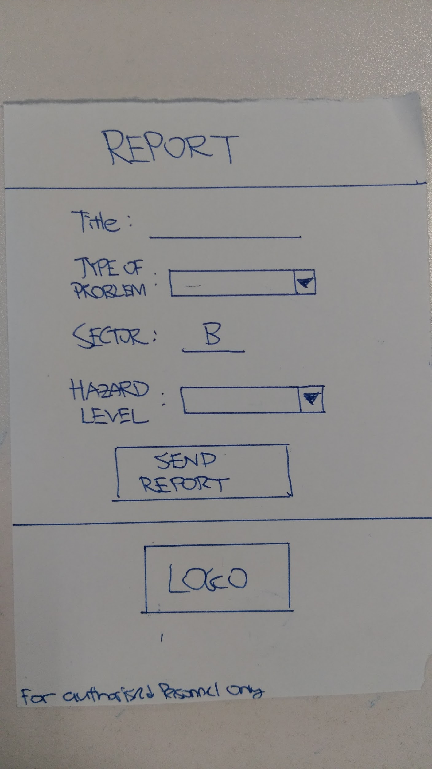
Paper prototype 2 (contd.)
The page gives a detailed report of the obstacle spotted
The report includes the type of the problem identified and the sector area it is found
The staff can key in the hazard level based on the obstacle review
A send report feature is included as a clickable button in a box format at the bottom of the report

Slide 72
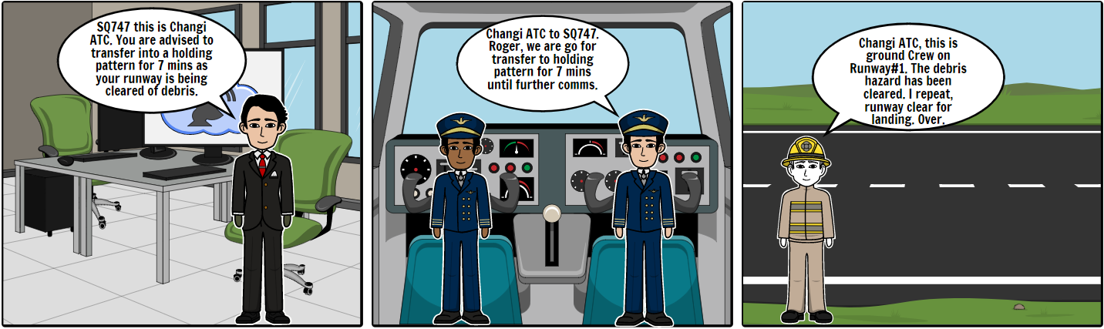
Storyboard 2

Slide 73
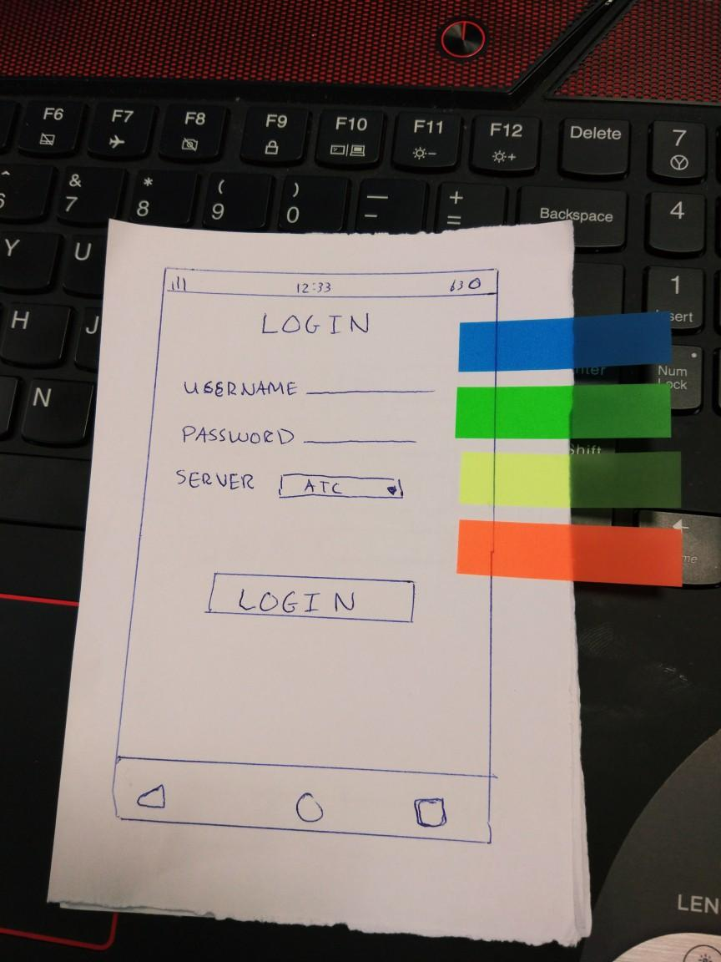
Zen voting for final prototype
Our team conducted zen voting to choose between our two paper prototype. The chosen final prototype will be developed into a clickable prototype for further testing.
As shown here, the paper prototype based on Sandeep’s sketch was chosen to be developed further and be our clickable prototype to be used for upcoming user testing.

Slide 74
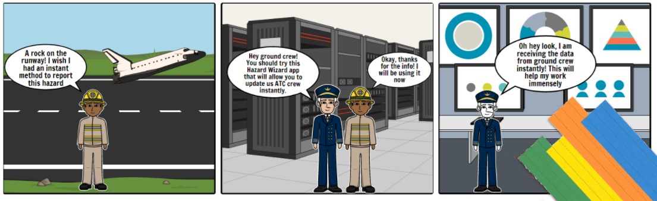
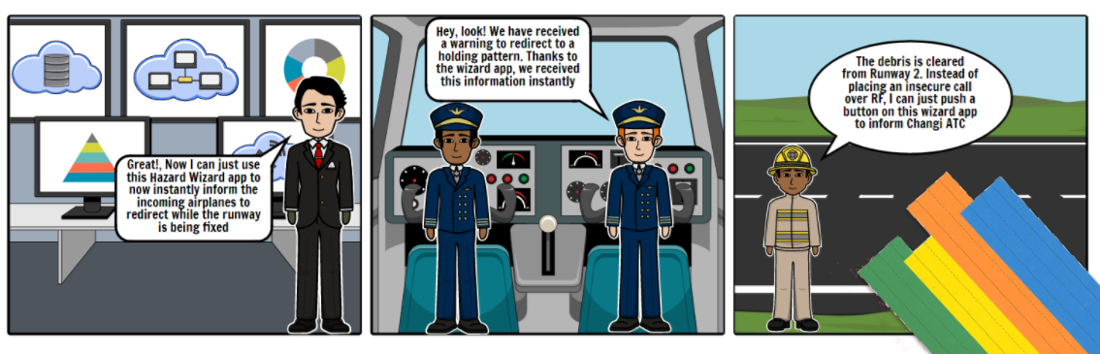
Zen voting for Storyboard
Our team conducted Zen voting to choose the two storyboards that best represent our idea. The process resulted in the following two being chosen.
They accurately portray how by using our Hazard Wizard application, it significantly improves the response time and security of the entire process.

Slide 75
Understand
Reflect
Diverge
Test
Day 1
Converge
Day 2
Prototype
Reflect
Test
Prototype

Slide 76
Five act Interview Structure
1. Introduction
“Hi, good morning <interviewee name>!
My name is <interviewer name> from Team CUBS and we are working on the topic ‘Area 1 - Problem 3 - Safety Checks’.
We would like to ask you a few questions to help us better understand how we can further improve upon our sprint project and our prototype.”

Slide 77
Five act Interview Structure (contd.)
2. List of questions about the customer
Have you ever travelled by airplane?
Do you fly international or domestic?
Have you ever experienced issues during landing or take off? (Delays or rough landing)
Did these issues cause large delays?
How were these situations handled by the Airlines?

Slide 78
Five act Interview Structure (contd.)
3. Introduction to the Prototype (Text)
“I would like to take a minute to explain our prototype.
Our team is developing an application for the Changi Airport Authorities, and in specific their Air-Traffic Control Tower.
This application will aid in better handling debris and wildlife hazards on the runways by reducing manual labor, and introducing automated machine learning to reduce response times in the event of a crisis.”

Slide 79
Five act Interview Structure (contd.)
4. List of tasks to get customer reacting to the Prototype
Navigate all pages of our prototype
View Camera and Thermal Imaging feeds
View Live Reports tab
View Live Map
Log Out of the application

Slide 80
Five act Interview Structure (contd.)
5. Quick debrief to understand customer’s thoughts and impressions
“Now that we’ve successfully completed the testing-act, lets do a quick run-through of the interview and the testing process.
Can you give us your overall impression towards our prototype?
In your opinion, what part of the prototype can be improved?
To conclude, thank you for your time and patience for participating in the interview and usability testing process of our prototype.”

Slide 81
Understand
Reflect
Diverge
Test
Day 1
Converge
Day 2
Prototype
Reflect
Test
Prototype

Slide 82
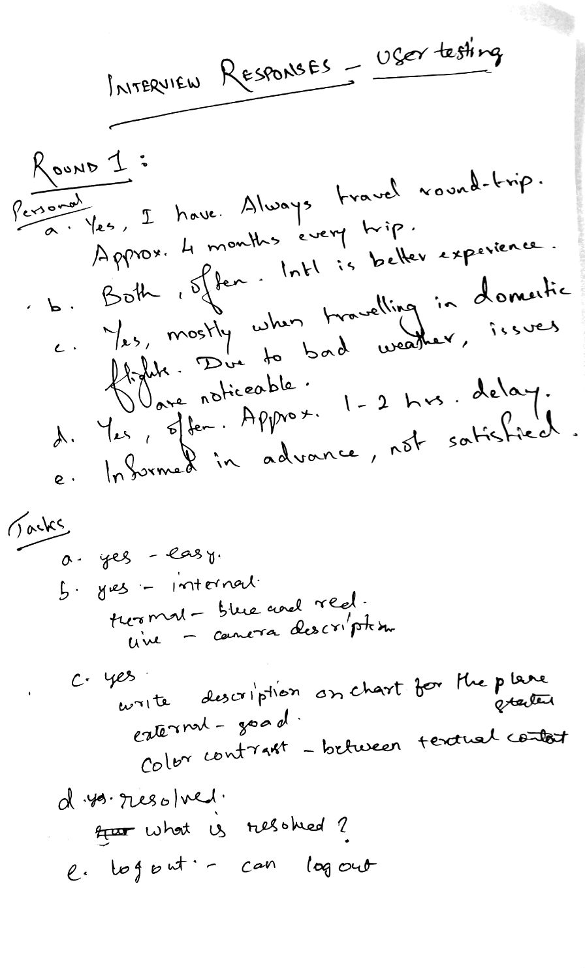
User Testing 1 (Audio log - https://goo.gl/aAhYxn)

Slide 83
Changes after Testing 1
Upgraded the runway status
Reports were introduced with a new page
Adjusted the color contrast to highlight the textual content on the reports page
The unresolved status will be addressed with an empty check box
Added more images to display camera views

Slide 84
Three words
What 3 words did the tester/user use to describe your product
Easy to use
What 3 words did you use to describe your product in the Understand Stage
Easy to navigate

Slide 85
Understand
Reflect
Diverge
Test
Day 1
Converge
Day 2
Prototype
Reflect
Test
Prototype

Slide 86
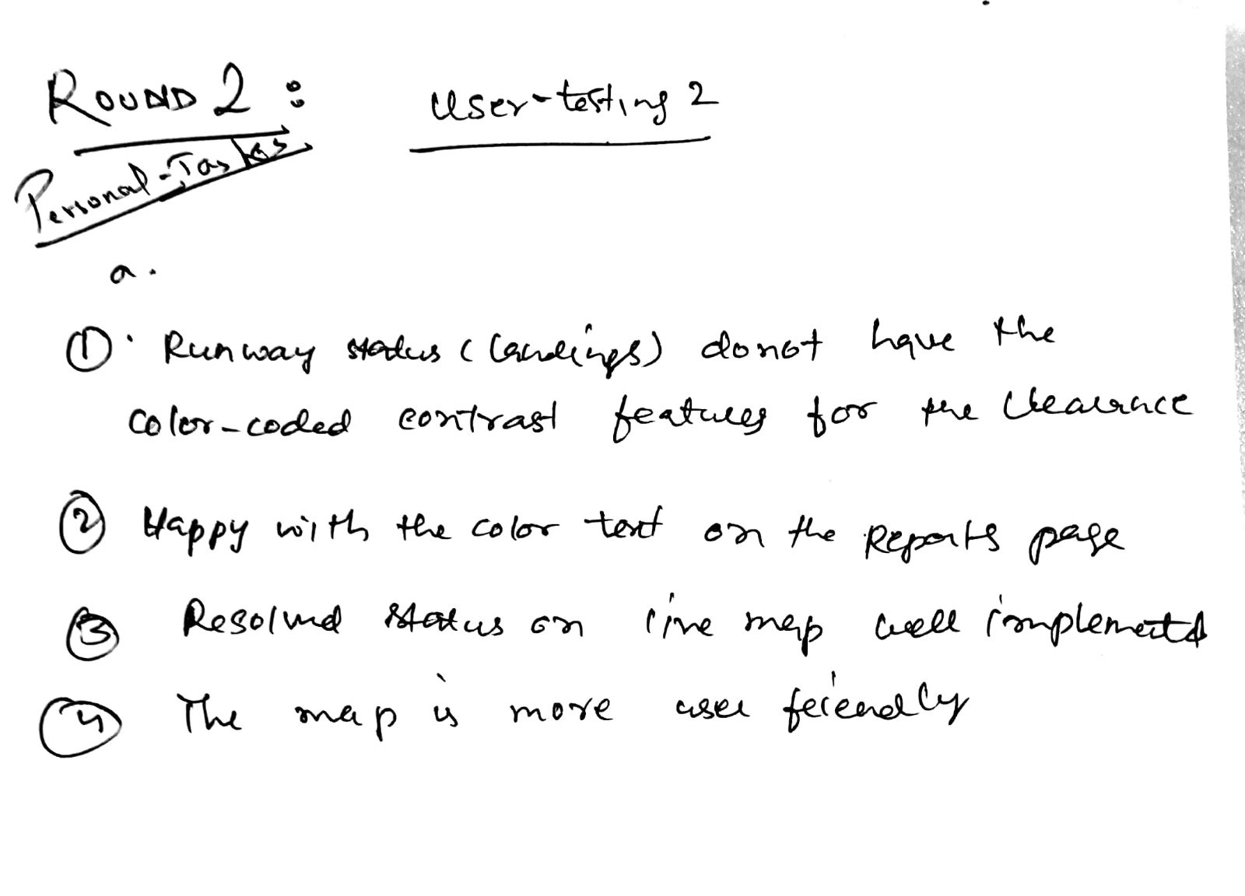
User Testing 2 (Audio log - https://goo.gl/RhNcVg)

Slide 87
Three words for testing 2
What 3 words did the tester/user use to describe your product
Structured, Visual, Aesthetics
What 3 words did you use to describe your product in the Understand Stage
Simplistic, Dynamic, Minimal

Slide 88
Changes after Testing 2
Login page was revised
Changed the handling of the live feed
Added incident when we click on them, the camera pop up

Slide 89
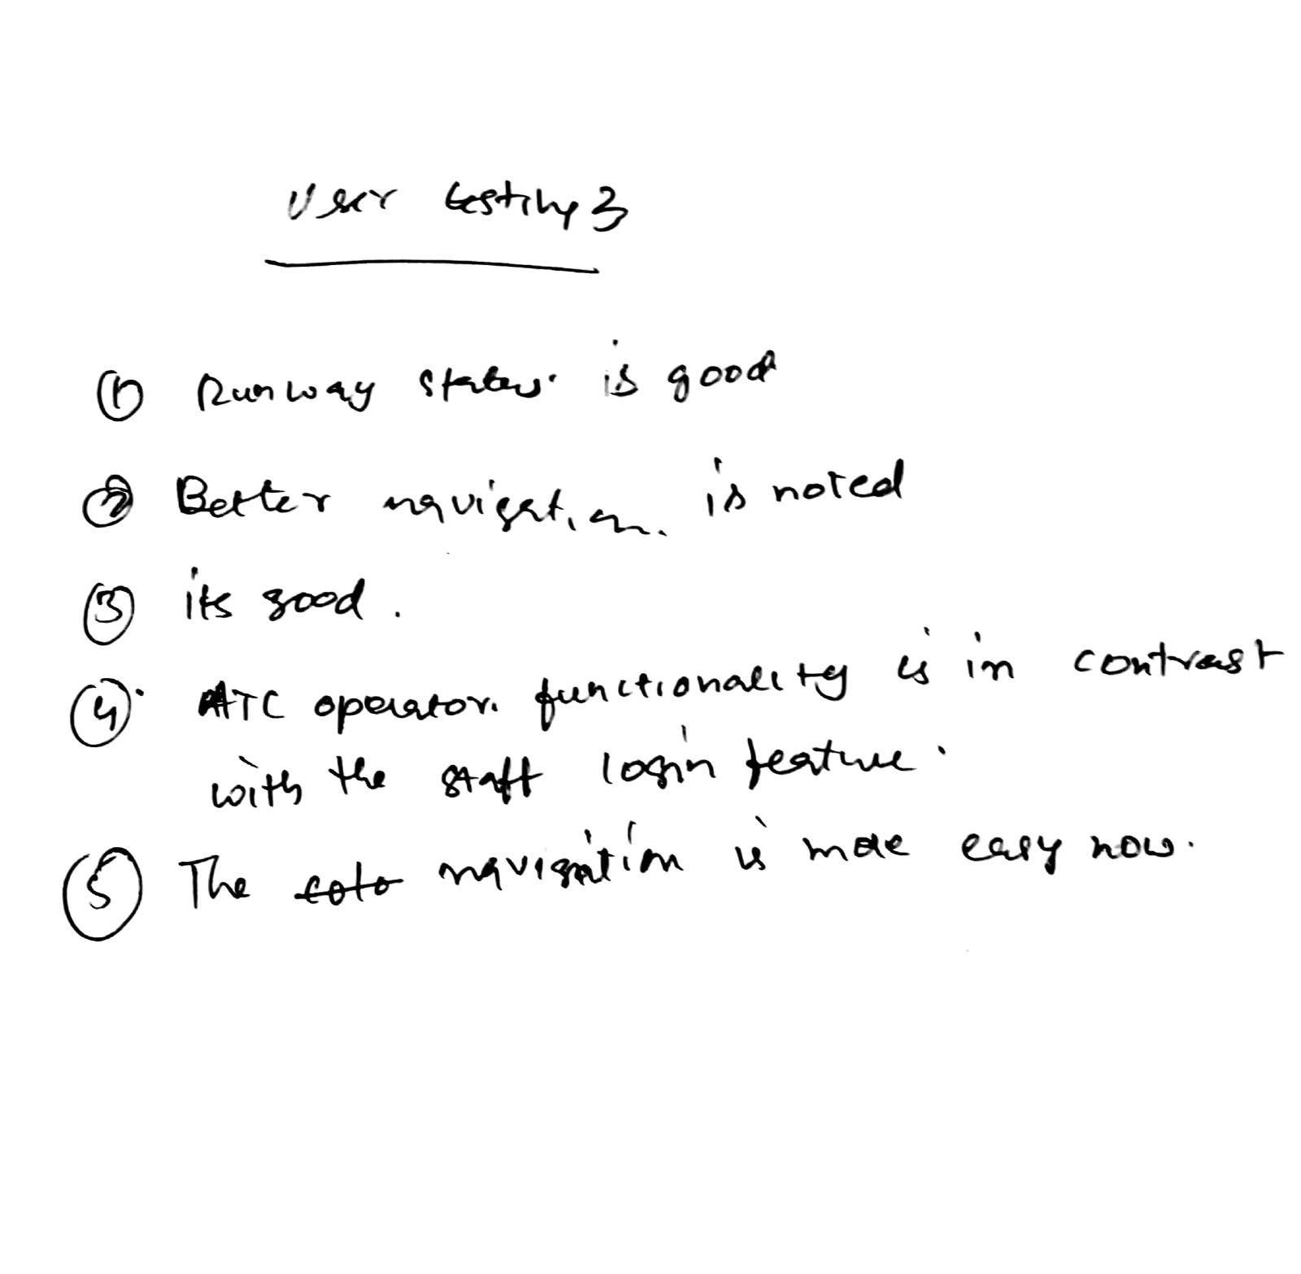
User Testing 3 (Audio log - https://goo.gl/mzpQmQ)

Slide 90
Three words for testing 3
What 3 words did the tester/user use to describe your product
Clear, Concise, Informative
What 3 words did you use to describe your product in the Understand Stage
Ambitious, Constructive, Visualisation

Slide 91
Changes after Testing 3
Changed the way data was written in the reports
We added pop-ups and buttons on the runway status to clear the issues.
A supervisor contact page added so that the groundcrew can contact the ATC
Added two accounts for the ATC and the ground crew login.

Slide 92
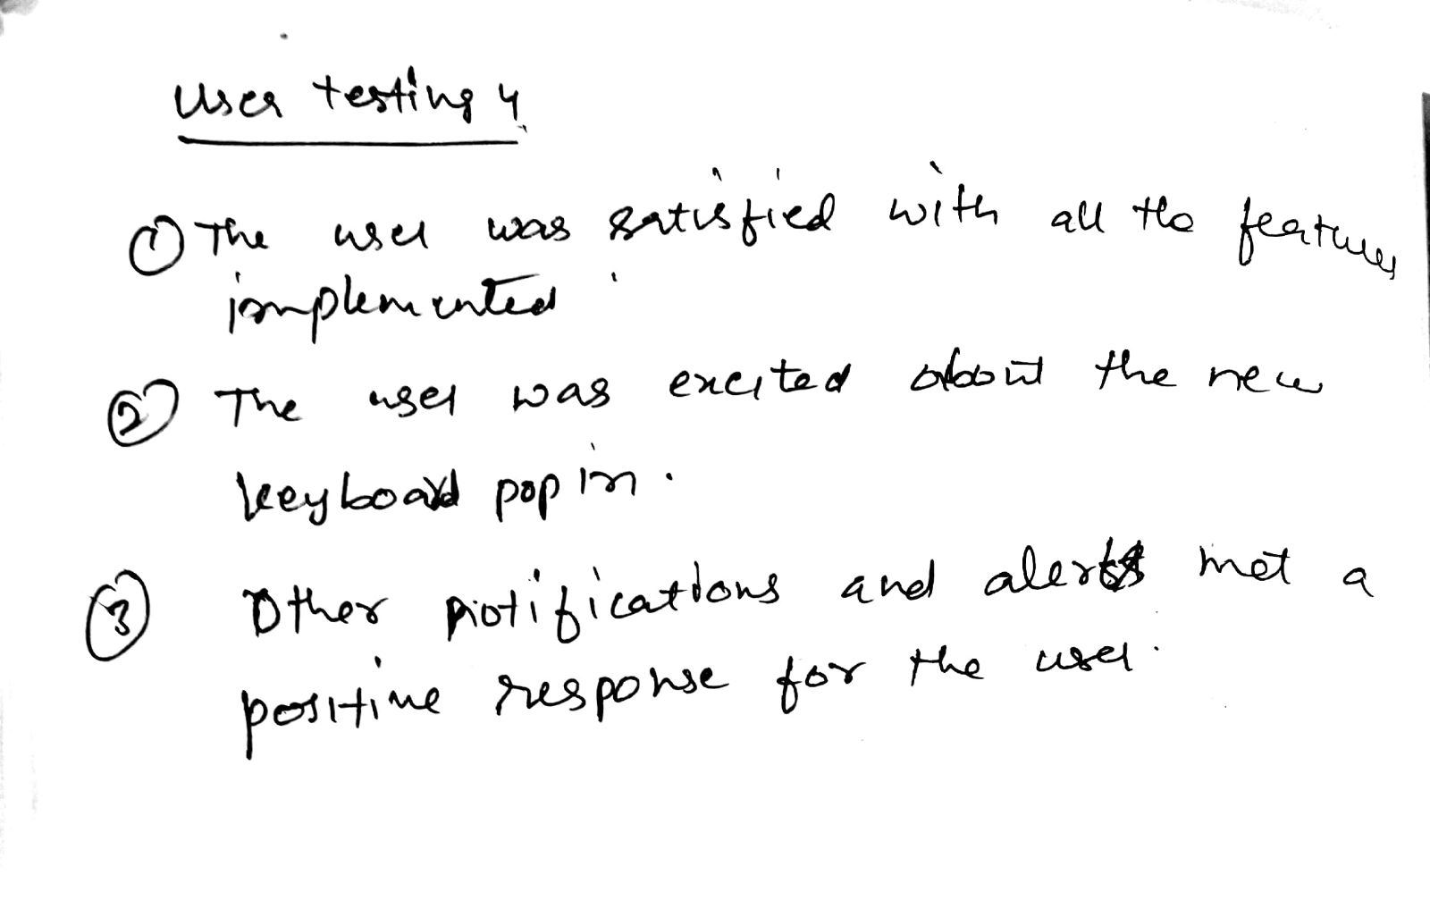
User Testing 4 (Audio log - https://goo.gl/yJ3QD2)

Slide 93
Three words after testing 4
What 3 words did the tester/user use to describe you?
Novel, Fulfilling, Inclusive
What 3 words did you use to describe your product in the Understand Stage
Implementable, Working, Solution

Slide 94
Changes after Testing 4
Added a keyboard functionality to the contact
General formatting of all text and buttons
Added notifications and alerts

Slide 95
User Testing Results Summary
The first user testing set the path for the application to be streamlined. A few missing pages were added and the overall design was upgraded. The user identified a few key missing features as well, which includes the color scheme on the thermal and the live images
The second user testing saw the application move from a basic design to a visually appealing design. The live map was now updated with dots hich are clickable and lead to the image of the runway view.Key issues like textual contrast on charts and resolved status updates which were identified in the first user texting were corrected.
The third user testing saw the implementation of two user login methods, one for the ATC and the other for the ground with two levels of privilege.
The fourth user testing saw the implementation of the keyboard pop-in feature in the app.The final design also included notification alerts and the user was fully satisfied with the end result.

Slide 96
Understand
Reflect
Diverge
Test
Day 1
Converge
Day 2
Prototype
Reflect
Test
Prototype

Slide 97
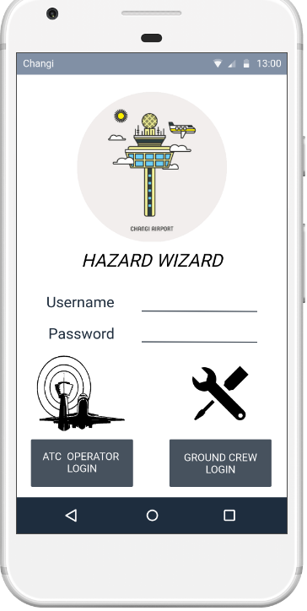
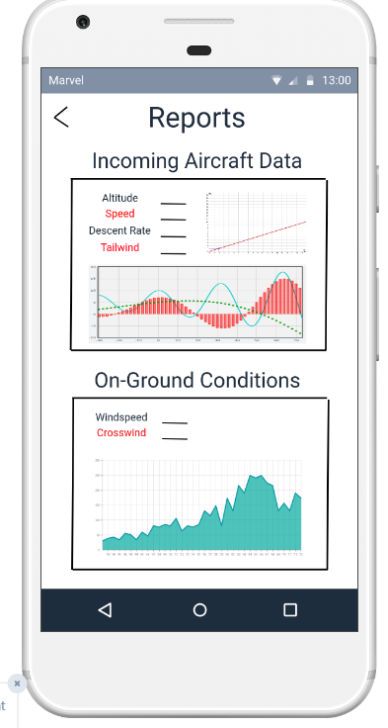
Final Prototype Link - Marvel
https://marvelapp.com/5hc885g

Slide 98
Design Sprint Daily Reflection – Plus/Delta Approach
+
User testing was successful and captured relevant points to better prototypes. Each iteration showed progress. Marvel was fully utilised to create detailed representation of features. Team worked well under pressure, especially with the steep time limit. Precise communication and delegation of tasks since the start of the day | Add more detailed steps between iterations Add an extra iterations to fine tune any issues Have more than one user doing the user testing

Slide 99
Design Sprint Other Comments
Understand
Reflect
Diverge
Test
Day 1
Converge
Day 2
Prototype
Reflect
Test
Prototype

